Slide 1
Almost Random Projection Machine with Margin Maximization and Kernel Features
Tomasz Maszczyk
and
Włodzisław Duch
Department of Informatics,
Nicolaus Copernicus University, Toruń, Poland
ICANN 2010

Slide 2
Plan
Main idea
Inspirations
Description of our approach
Influence of margin maximization
Results
Conclusions

Slide 3
Main idea
backpropagation algorithm for training MLP – non-linear systems, non-separable problems, slowly
MLP are simpler than biological NN
backpropagation is hard to justify from neurobiological perspective
algorithms capable of solving problems of similar complexity – important chalange, needed to create ambitious ML applications

Slide 4
Inspirations
neurons in association cortex form strongly connected microcircuits found in cortical minicolumns, resonate in diffrent frequencies
perceptron observing these minicolumns learn to react on specific signals around particular frequency
resonators do not get excited when overall activity is high, but rather when specific levels of activity are reached

Slide 5
Main idea
Following these inspirations - aRPM, single hidden layer constructive network based on random projections added only if useful;
easily solve highly-non-separable problems
Kernel-based features; extends the hypothesis space – Cover theorem

Slide 6
Main idea
Linear kernels define new features t(X;W)=K_{L}(X,W)=X·W based on a projection on the W direction.
Gaussian kernels g(X,W)=exp(-||X-W||/(2σ²)) evaluate similarity between two vectors using weighted radial distance function.
The final discriminant function is constructed as a linear combination of such kernels.
Focus on margin maximization in aRPM; new projections added only if increase correct classification probability of those examples that are wrong classified or are close to the decision border.

Slide 7
aRPM
Some projections may not be very useful, but the distribution of the training data along direction may have a range of values that includes a pure cluster of projected patterns. This creates binary features b_{i}(X) = t(X;W_{i},[t_{a},t_{b}]) ϵ {0,1}, based on linear restricted projection in the direction W.
Good candidate feature should cover some minimal number η of training vectors.

Slide 8
aRPM
Features based on kernels - here only Gaussian kernels with several values of dispersion σ g(X;X_{i},σ)=exp(-||X_{i}-X||²/2σ²).
Local kernel features have values close to zero except around their support vectors X_{i}. Therefore their usefulness is limited to the neighborhood O(X_{i}) in which g_{i}(X)>ϵ.

Slide 9
aRPM
To create multi-resolution kernel features – first with large σ (smooth decision borders), then smaller σ (features more localized).
The candidate feature is converted into a permanent node only if it increases classification margin.
Incremental algorithm, expand feature space until no improvements; move vectors away from decision border.

Slide 10
aRPM
WTA - sum of the activation of hidden nodes. Projections with added intervals give binary activations b_{i}(X), but the values of kernel features g(X;X_{i},σ) are summed, giving a total activation A(C|X) for each class.
Plotting A(C|X) versus A(¬C|X) for each vector leads to scatterograms, giving an idea how far is a given vector from the decision border.

Slide 11
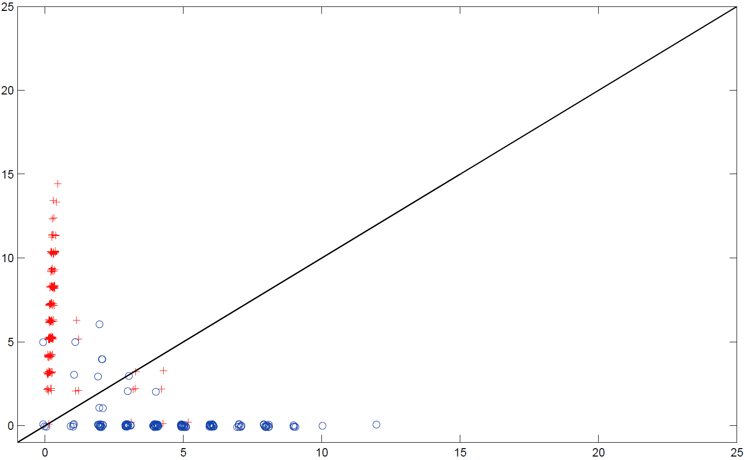
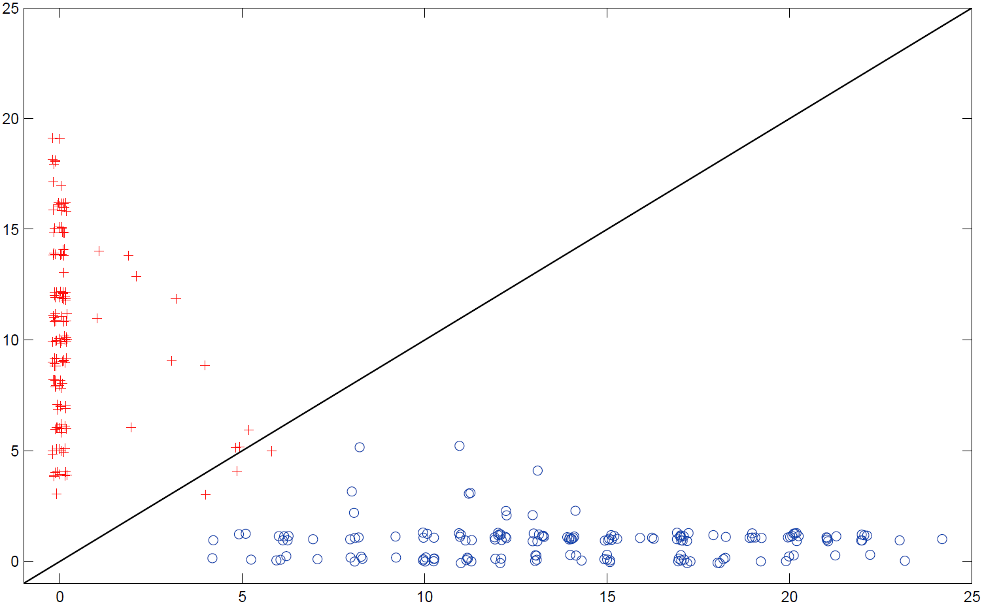
no margin maximization
with margin maximization

Slide 12
aRPM
In the WTA |A(C|X)-A(¬C|X)| estimates distance from the decision border.
Specifying confidence of the model for vector XϵC using logistic function:
F(X)=1/(1+exp(-(A(C|X)-A(¬C|X))))
gives values around 1 if X is on the correct side and far from the border, and goes to zero if it is on the wrong side.
Total confidence in the model may then be estimated by summing over all vectors.

Slide 13
aRPM
The final effect of adding new feature h(X) to the total confidence measure is therefore:
U(H,h)=Σ (F(X;H+h) - F(X;H))
If U(H,h)>α than the new feature is accepted providing a larger margin.
To make final decision aRPM with margin maximization uses WTA mechanism or LD.

Slide 15
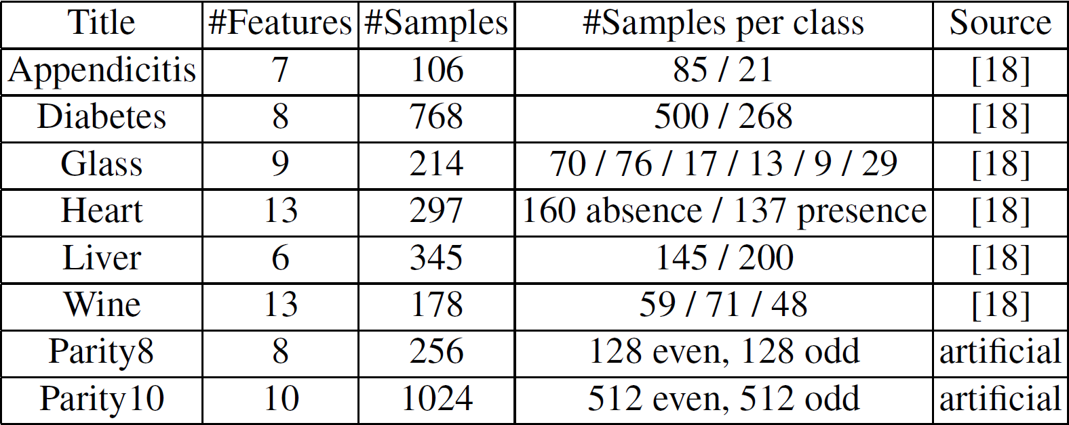
Datasets

Slide 16
Results

Slide 17
Conclusions
aRPM algorithm improved in two ways: by adding selection of network nodes to ensure wide margins, and by adding kernel features.
Relations to kernel SVM and biological plausibility make aRPM a very interesting subject of study. In contrast to typical neural networks that learn by parameter adaptation there is no learning involved, just generation and selection of features.
Shifting the focus to generation of new features followed by the WTA, makes it a candidate for a fast-learning neural algorithm that is simpler and learns faster than MLP or RBF networks.

Slide 18
Conclusions
Feature selection and construction, finding interesting views on the data is the basis of natural categorization and learning processes.
Scatterogram of WTA output shows the effect of margin optimization, and allows for estimation of confidence in classification of a given data.
Further improvements: admission of impure clusters instead of binary features, use of other kernel features, selection of candidate SV and optimization of the algorithm.

Slide 19
Thank You!

