Slide 1
Autism Spectrum Disorders & ADHD: some conclusions from computational simulations
Włodzisław Duch & Co
Department of Informatics, Nicolaus Copernicus University, Toruń, Poland
Google: W. Duch
26th Marian Smoluchowski Symposium on Statistical Physics
Complexity of Brain – Critical Behavior and Scaling, Kraków 28.31-.08.2013

Slide 2
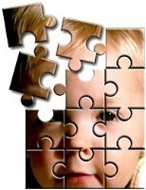
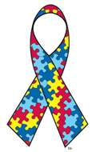
Plan:
How can we understand neurodegenerative disease, such as autism, ADHD or epilepsy?
Who is in the best position to do it?
Observations: what do we know?
Theories: do we understand it?
Computational experiments.
Mistaking symptoms for causes.
Experimental evidence.
Informed guesses, aka speculations
April is celebrated as the autism awareness month since 1970.

Slide 3
Interdisciplinary Center of Innovative Technologies
Why am I interested in this?
Science without borders …
Neurocognitive lab, including infant lab and many other projects, mostly experimental: fMRI + EEG, TMS, audiology, Cantab workstation etc ...
Still waiting for some equipment and furniture.
Understanding brain plasticity, development, mental states.
Funding >1M$ for infant lab.

Slide 4
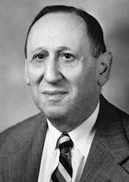
A bit of ASD history
ASD: Autism Spectrum Disorder, includes many forms of autism.
Described for the first time in 1943 by Leo Kanner:
“extreme aloneness from the beginning of life and anxiously obsessive desire for the preservation of sameness.”
“… these children have come into the world with innate inability to form the usual, biologically provided affective contact with people … ”.
Common deficit: lack of the theory of mind.
Initial theories:
bad parents, refrigerator mothers ...
a behavioral syndrome … a developmental syndrome ...
multiple disease entities, multiple etiologies, including metabolic and immune system deregulation, genetics.
2008: However, as in many areas of neuroscience, we are ‘‘data rich and theory poor’’ (Zimmerman, Autism – current theories).

Slide 5
ASD
Autism Spectrum of Disorders includes:
Autism, Asperger syndrome, pervasive developmental disorder not otherwise specified (PDD-NOS), atypical forms of childhood disintegrative disorder, Rett syndrome, Infantile Autistic Bipolar Disorder (IABD), purine autism.
4-5 times more boys than girls.
CDC estimates: average about 1%, boys about 2%.
Autistic Savants:
few percent of people with ASD learn unusual memory
or motor skills, but are impaired in many other ways.

Slide 6
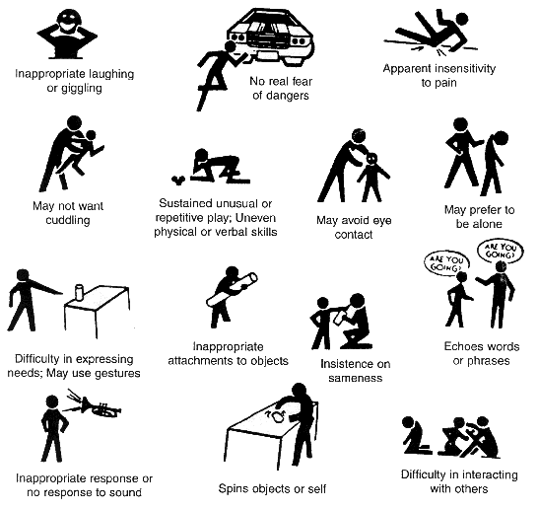
Autism Symptoms ...
Epidemics?
Not clear why: more attention, better diagnostics?
Very diverse, not a single disease, but more like dementia.
Genetic component, but search for “autism genes” not too successful, too many are involved.
Genetics cannot explain recent rapid increase.

Slide 7
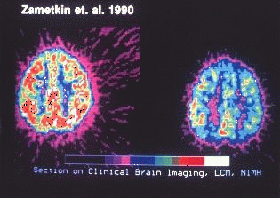
ADHD
Attention Deficit Hyperactivity Disorder, 3-5% of population (also adults).
Problems with attention: usually impulsive-hyperactive, inattentive (ADD)
Lack of impulse control, easily distracted, miss details, forget things, frequently switch between activity, can’t focus on one thing …
Motor restlessness, run non-stop, lose things, are very impatient, display strong emotions, act without thinking about consequences.
Bored quickly, daydream, difficulty in learning new things, complete homework.
ADHD involves functional disconnections between frontal and occipital cortex (A. Mazaheri et al, Biological Psychiatry 67, 617, 2010); psychologist talk about deficit in "top-down" attention control.
In many respects it is the opposite of ASD.

Slide 8
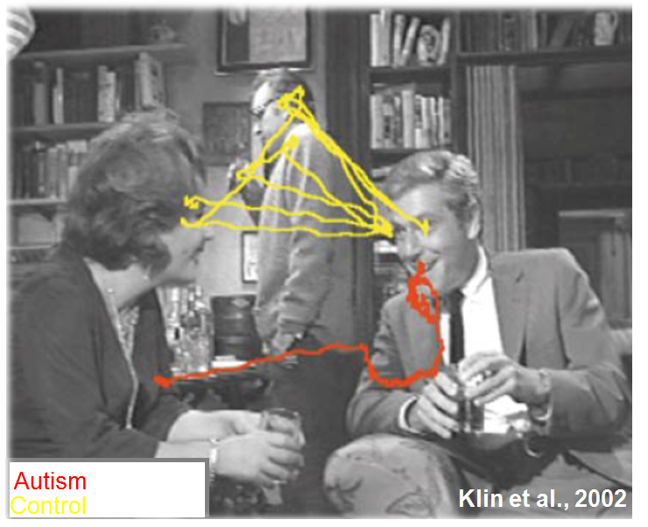
Eye saccades

Slide 9
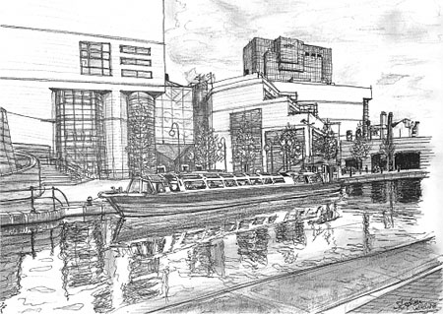
Autism: hyperspecificity
Steven Wiltshire,
http://www.stephenwiltshire.co.uk
See also: Grandin Temple, Thinking in pictures and Other Reports from My Life with Autism (Vintage Books, 1996)

Slide 10
Anthropologist from Mars
Temple Grandin, "The Woman Who Thinks Like a Cow”(BBC special) http://templegrandin.com/

Slide 11
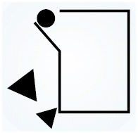
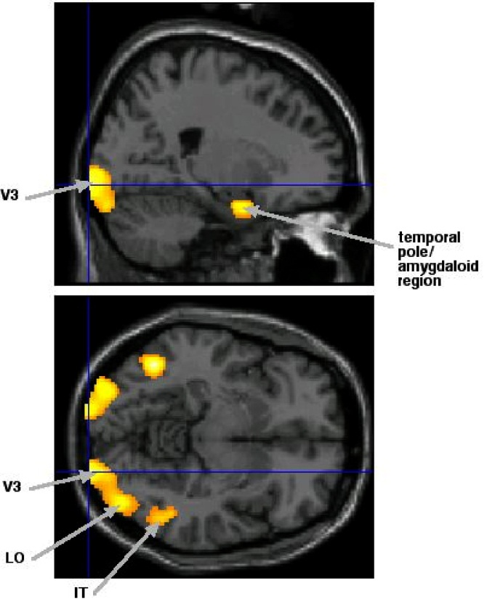
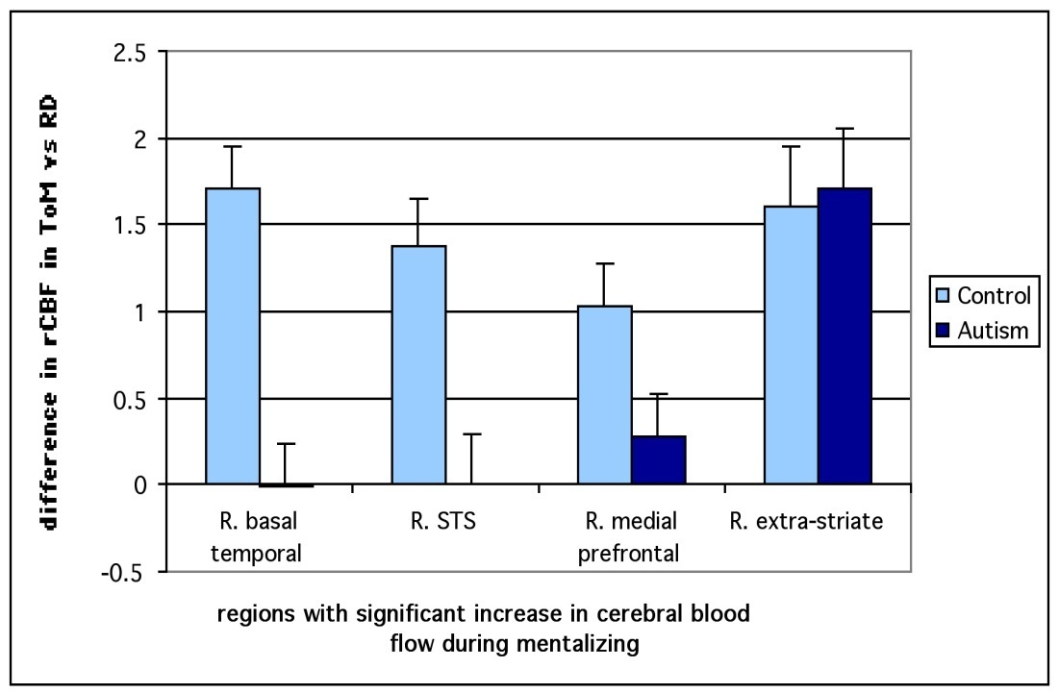
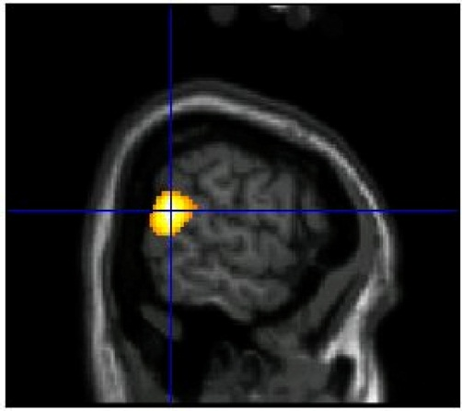
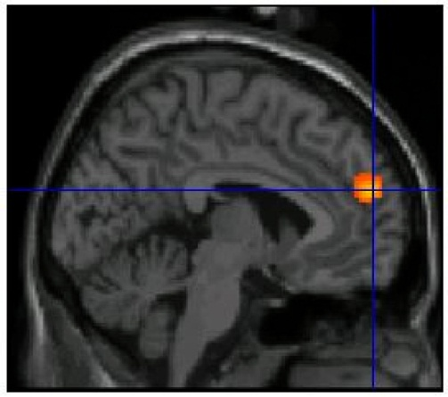
Reading intentions
Animation shows the circle as a victim,
Small triangle tries to help, big one is aggressive.
Autism, Asperger syndrome and brain mechanisms for the attribution of mental states to animated shapes. F. Castelli & et al. Brain 2002, 125 : 1839-49

Slide 12
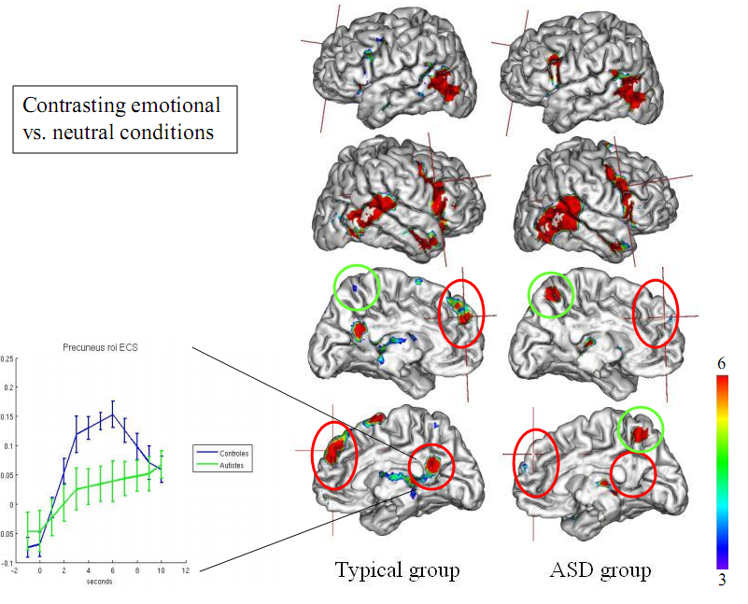
Source: Bruno Wicker (CNRS)

Slide 13
Theories, theories
Best book on ASD so far:
Andrew W. Zimmerman (Ed.) Autism; current theories and evidence. Humana Press 2008.
20 chapters divided into six sections:
Molecular and Clinical Genetics (4 chapters);
Neurotransmitters and Cell Signaling (3 chapters);
Endocrinology, Growth, and Metabolism (4 chapters);
Immunology, Maternal-Fetal Effects, and Neuroinflammation (4 chapters);
Neuroanatomy, Imaging, and Neural Networks (3 chapters);
Environmental Mechanisms and Models (2 chapters).
Other: Grossberg ART model. At which level can we understand not just correlations, but real mechanisms responsible for behavioral symptoms?
(genes, proteins, biochemistry, ion channels, synapses, membranes) ⬄ (neural properties, networks) ⬄ (behavior, syndromes, disease).

Slide 14
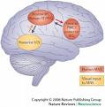
Mirror Neuron System
MNS: observing action elicits similar motor activations as if it had been performed by oneself; visuo-motor neurons.
This helps to understand actions of others, modeling behavior via embodied simulation of their actions, intentions, and emotions.
MNS theory of autism (Williams et al, 2001): distortion in the development of the MNS interferes with the ability to imitate, leads to social impairment and communication difficulties.
Correlations between reduced MNS activity and severity of ASD are strong.
Problems:
In ASD abnormal brain activation is seen in many other circuits; performance of autistic children on various imitation tasks may be normal.
MNS is used to explain almost everything in social neuroscience, but MNS is not really a special subsystem, just multimodal neurons.

Slide 15
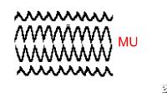
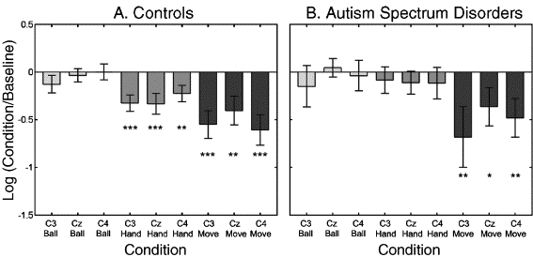
MNS EEG
EEG on controls and autistics on 4 different tasks, comparing mu rhythms. Baseline: large amplitude mu oscillations in synchrony. Seeing an action causes mu rhythms to fire asynchronously resulting in mu suppression.
Mu wave suppression reflects activity of the mirror neuron system.
In autistics mu is suppressed for own hand movements (Oberman 2005), but not for the observed hand movements of others (hand vs. move).

Slide 16
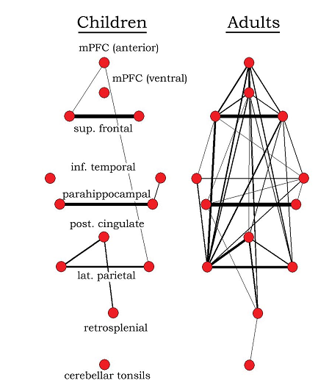
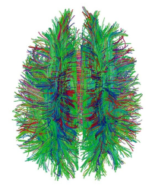
Reduced functional connectivity
The underconnectivity theory of autism is based on the following:
Excess of low-level (sensory) processes.
Underfunctioning of high-level neural connections and synchronization,
fMRI and EEG study suggests that adults with ASD have local overconnectivity in the cortex and weak functional connections between the frontal lobe and the rest of the cortex.
Underconnectivity is mainly within each hemisphere of the cortex and that autism is a disorder of the association cortex.
Patterns of low function and aberrant activation in the brain differ depending on whether the brain is doing social or nonsocial tasks.
“Default brain network” involves a large-scale brain network (cingulate cortex, mPFC, lateral PC), shows low activity for goal-related actions; it is active in social and emotional processing, mindwandering, daydreaming.
Activity of the default network is negatively correlated with the “action network” (conscious goal-directed thinking), but this is not the case in autism – perhaps disturbance of self-referential thought?

Slide 17
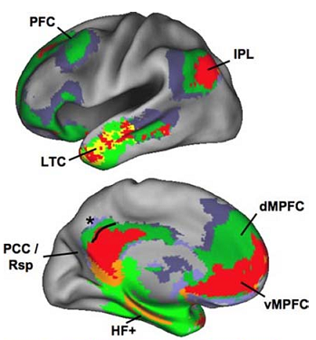
Reduced functional connectivity
The underconnectivity theory of autism is based on the following:
Excess of low-level (sensory) processes.
Underfunctioning of high-level neural connections and synchronization,
fMRI and EEG study suggests that adults with ASD have local overconnectivity in the cortex and weak functional connections between the frontal lobe and the rest of the cortex.
Underconnectivity is mainly within each hemisphere of the cortex and that autism is a disorder of the association cortex.
Patterns of low function and aberrant activation in the brain differ depending on whether the brain is doing social or nonsocial tasks.
“Default brain network” involves a large-scale brain network (cingulate cortex, mPFC, lateral PC), shows low activity for goal-related actions; it is active in social and emotional processing, mindwandering, daydreaming.
Activity of the default network is negatively correlated with the “action network” (conscious goal-directed thinking), but this is not the case in autism – perhaps disturbance of self-referential thought?

Slide 18
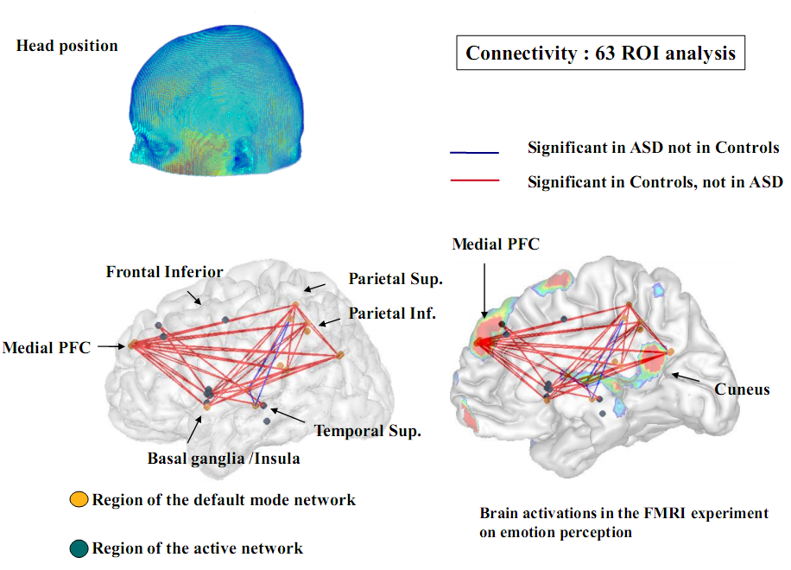

Slide 19
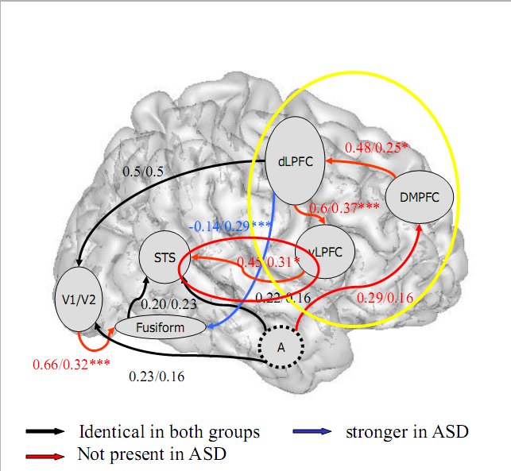
Effective brain connections
B. Wicker et al.
SCAN 2008

Slide 20
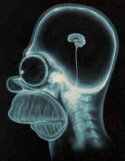
Executive dysfunction
Hypothesis: autism results mainly from deficits in working memory, planning, inhibition, and other executive functions.
Executive processes do not reach typical adult levels, resulting in stereotyped behavior and narrow interests.
But executive function deficits have not been found in young autistic children.
Weak central coherence theory hypothesizes that a limited ability to see the big picture underlies the central disturbance in autism.
This predicts special talents in performance of autistic people.
Enhanced perceptual functioning theory focuses more on the superiority of locally oriented and perceptual operations in autistic individuals.
These theories agree with the underconnectivity theory of autism.
Social cognition theories poorly address autism's rigid and repetitive behaviors, while the nonsocial theories have difficulty explaining social impairment and communication difficulties.

Slide 21
Function connectivity theory
Model developed over 20 years (Nancy J. Minshew): autism as widespread disorder of association cortex, development of connectivity, only secondarily as a behavioral disorder. Fine, but still quite general.
Abnormalities in genetic code for brain development
↓
Abnormal mechanisms of brain development
↓
Structural and functional abnormalities of brain
↓
Cognitive and neurologic abnormalities
↓
Behavioral syndrome
Goal: understand the pathophysiology from gene to behavior, eventually the influence of etiologies on this sequence, ultimately support the development of interventions at multiple levels of the pathophysiologic sequence.

Slide 22
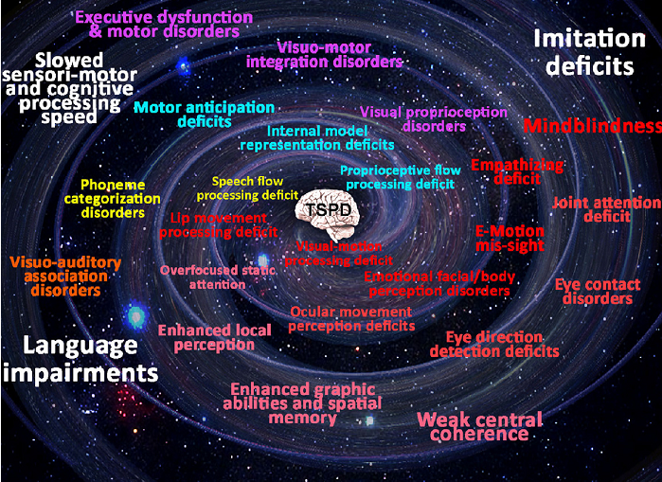
Temporo-spatial processing disorders
B. Gepner, F. Feron, Autism: A world changing too fast for a mis-wired brain? Neuroscience and Biobehavioral Reviews (2009).

Slide 23
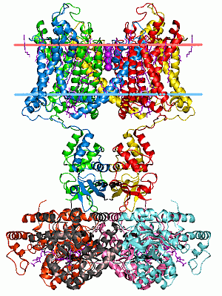
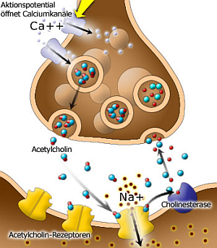
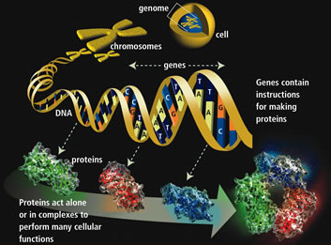
From Genes to Neurons
Genes => Proteins => receptors, ion channels, synapses => neuron properties, networks, neurodynamics => cognitive phenotypes, abnormal behavior, syndromes.

Slide 24
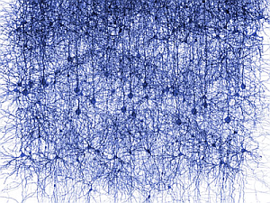
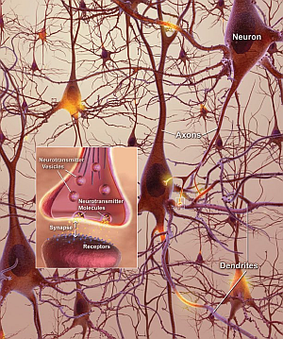
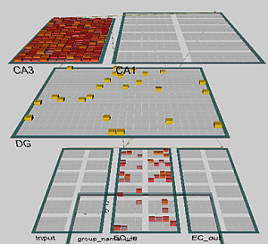
From Neurons to Behavior
Genes => Proteins => receptors, ion channels, synapses => neuron properties, networks
=> neurodynamics => cognitive phenotypes, abnormal behavior!

Slide 25
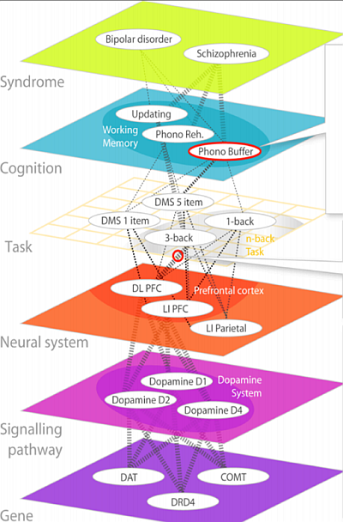
Neuropsychiatric Phenomics Levels
According to The Consortium for Neuropsychiatric Phenomics (CNP) http://www.phenomics.ucla.edu
From genes to molecules to neurons and their systems to tasks, cognitive subsystems and syndromes.
Neurons and networks are right in the middle of this hierarchy.

Slide 26
Neurocognitive Phenomics
Phenotypes may be described on many levels, here from top down: pedagogics, psychiatry, psychology,
neurophysiology, neural networks,
biology & neurobiology,
biophysics & biochemistry, bioinformatics.
Neurocognitive phenomics is needed for development of learning sciences, but it is even greater challenge than neuropsychiatric phenomics, effects are more subtle.
Learning styles, strategies
Learning styles
Memory types,
attention …
Cognition
Sensory & motor activity, N-back …
Tasks, reactions
Specialized brain areas, minicolumns
Neural networks
Many types of neurons
Synapses, neurons & glia cells
Neurotransmitters & modulators
Signaling pathways
Genes & proteins, brain bricks
Genes, proteins, epigenetics

Slide 27
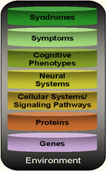
Neurophenomics Research Strategy
The Consortium for Neuropsychiatric Phenomics (2008): bridge all levels, one at a time, from environment to syndromes.
Our strategy: identify biophysical parameters of neurons required for normal neural network functions and leading to abnormal cognitive phenotypes, symptoms and syndromes.
Start from simple neurons and networks, increase complexity.
Create models of cognitive function that may reflect some of the symptoms of the disease, for example problems with attention.
Test and calibrate the stability of these models in a normal mode.
Determine model parameter ranges that lead to similar symptoms.
Relate these parameters to the biophysical properties of neurons.
Result: mental events at the network level are described in the language of neurodynamics and related to low-level neural properties. Example: relation of ASD/ADHD symptoms to neural accommodation.

Slide 28
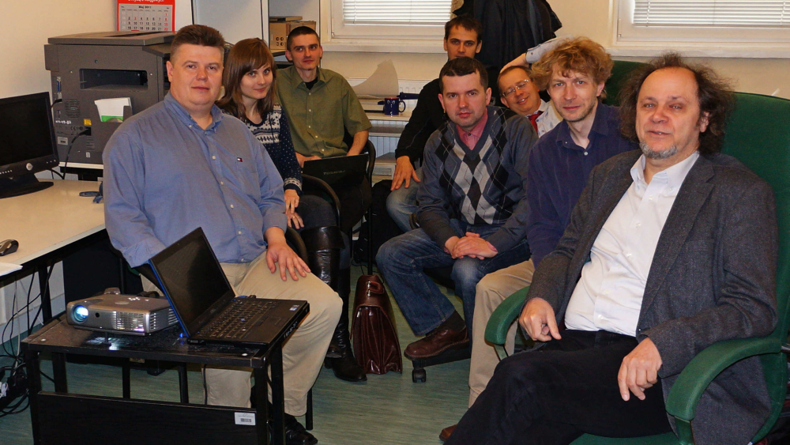
Research Group
Left to right: Darek Mikołajewski, Ewa Ratajczak, Krzysztof Dobosz, Grzegorz Markowski, Grzegorz Wójcik, Wiesław Nowak, Jarek Meller, Włodzisław Duch NCN (Polish National Science Foundation) Grant for pilot research.

Slide 29
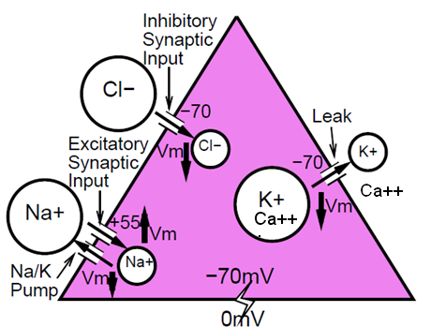
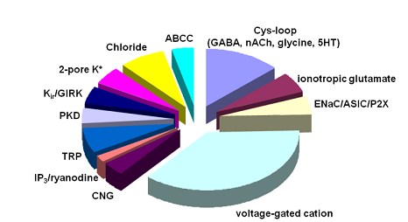
Computational Models
Models at various level of detail.
Minimal model includes neurons with 3 types of ion channels.
Models of attention:
Posner spatial attention;
attention shift between visual objects.
Models of word associations:
sequence of spontaneous thoughts.
Models of motor control.
Critical: control of the increase in intracellular calcium, which builds up slowly as a function of activation. Initial focus on the leak channels, 2-pore K⁺, looking for genes/proteins.

Slide 30
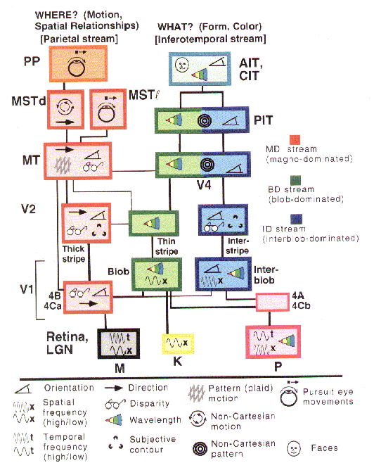
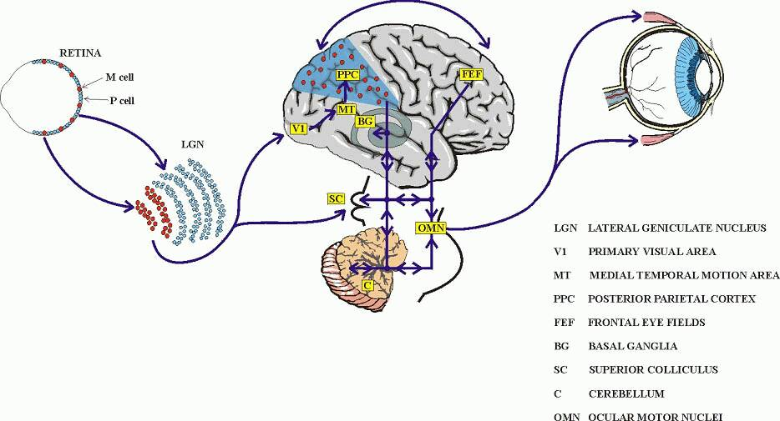
Vision
From retina through lateral geniculate body, LGN (part of thalamus) information passes to the primary visual cortex V1 and then splits into the ventral and dorsal streams.

Slide 31
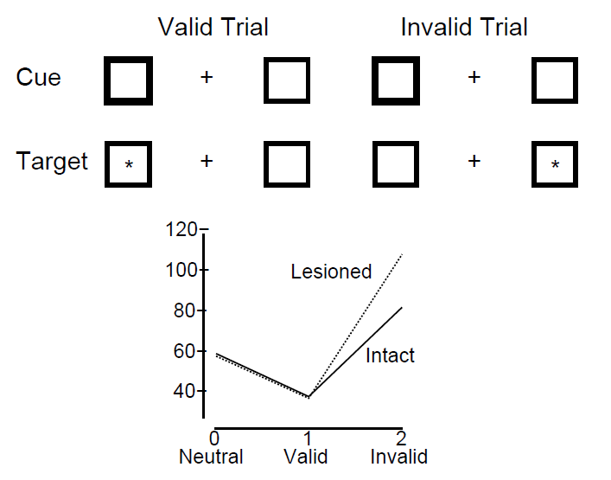
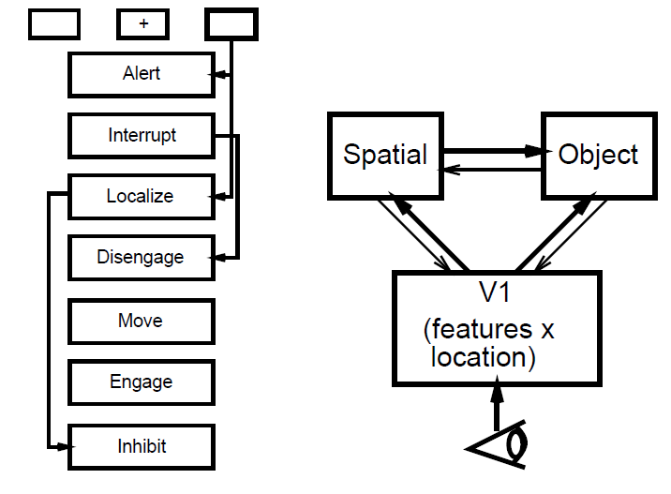
Posner visual orientation task
Cue (bright box) is in the same position as target (valid trial), or in another position (invalid trial), or there is no cue (neutral), just target.
Test of the object recognition/localization.

Slide 32
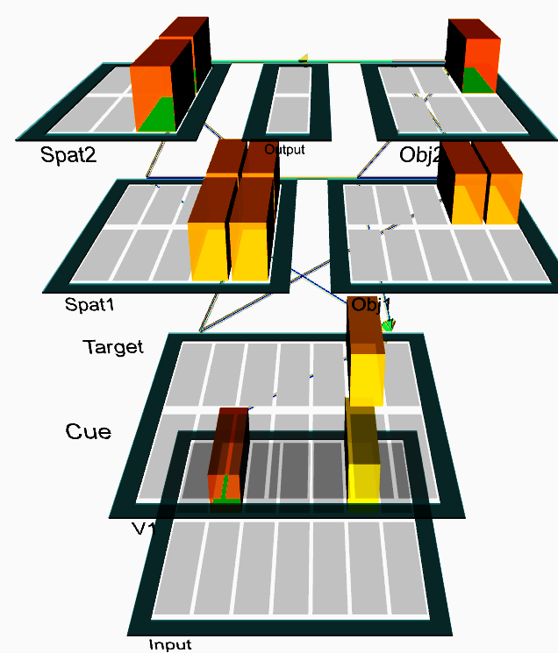
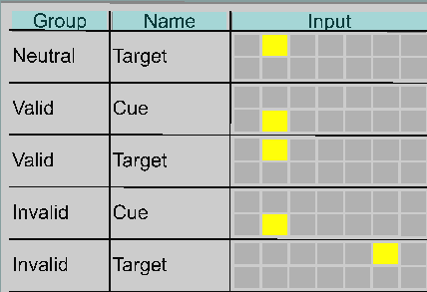
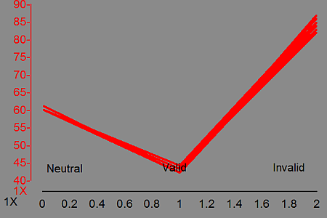
Posner spatial attention
Cue (bright box) is in the same position as target (valid trial), or in another position (invalid trial), or there is no cue (neutral).

Slide 33
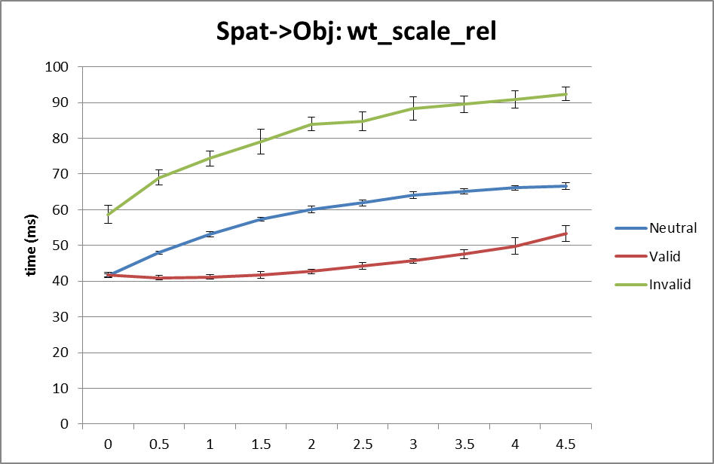
Posner: Spat ⬄ Obj
Relative strength of the influence of spatial attention on object recognition (Spat=>Obj) reduced to zero makes neutral and valid trial times identical, but leaves the 20 ms difference between valid and invalid cases (top-down modulation effect).
Increase of this relative strength leads to slow increase of all reaction times, but the 20 ms differences are fairly stable between scaling from 1 to 5, with tendency to increase the invalid/neutral difference to 30 ms and slightly decrease of valid/neutral trials difference.

Slide 34
Posner: V1=>Spat1
Decrease of relative strength of the influence of V1 layer on parietal spatial attention areas V1=>Spat1 leads to sharp increase in the invalid case, attention remains fixed for a longer time on the cue. Decrease of this parameter from 2 to 1 increases the time difference between neutral and invalid trials ~3 times. This may be one of the contributing factors to the problems with attention shifts in autism. While local circuits are well developed there is some evidence that distal connections are weak. Functional connections in autism have been linked to a variant of MET gene that shows high expression in the occipital cortex.
Judson M.C, Eagleson K.L, Levitt P.: A new synaptic player leading to autism risk: MET receptor tyrosine kinase. J. Neurodev. Disorders 3(3) (2011) 282–292

Slide 35
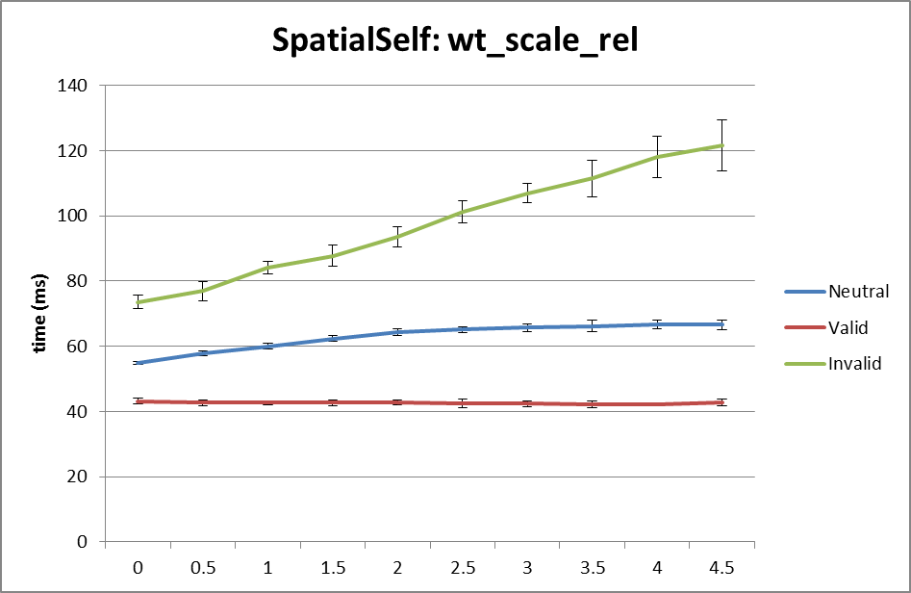
Posner: recurrence in Spat
Relative strength of recurrent connections in Spat1 and Spat2 layers has no influence on valid trials, weak influence on neutral, but stronger local connections significantly increase reaction times of invalid trials.
This mechanism may also contribute to long delays in shifts of attention.
TSC gene can cause local over-connectivity in the sensory cortices (visual, auditory) reducing normal neuronal pruning.

Slide 36
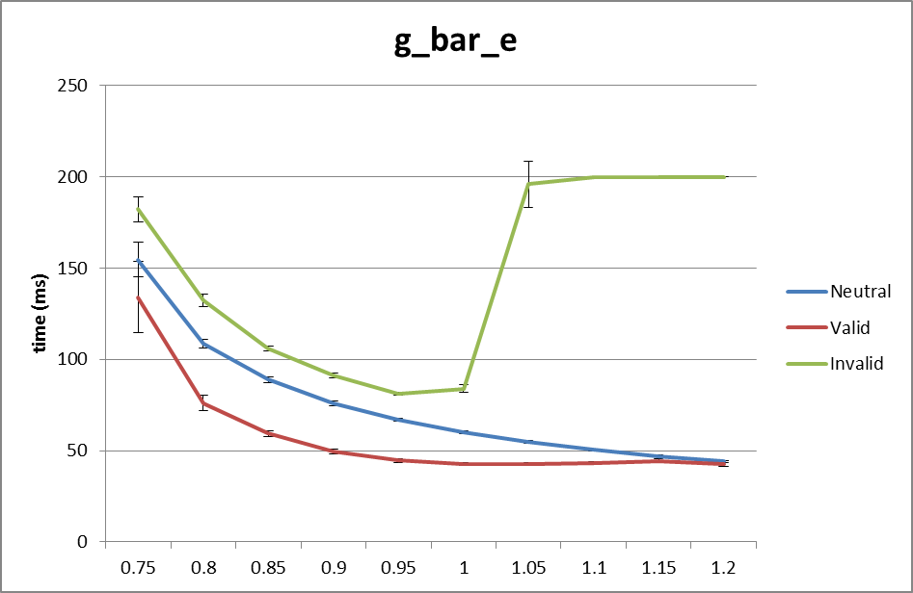
Posner: excitation/inhibition
Increase of maximal conductance for excitatory channels (mostly glutamatergic synaptic sodium channels) above 1 leads to sharp two-fold increase in invalid trial reaction times, and small decrease of the normal/valid trials reaction times;
decrease of this parameter slows down reaction times but keeps the differences roughly constant.
Increasing maximal conductance for inhibitory channels quickly increases the invalid trials reaction times without much change in results for other trials;
decrease has relatively small effect.

Slide 37
Posner: accomodation
Self-regulatory dynamics of neurons depends on complex processes, changing conductance of the ion channels (voltage-dependent gates).
Changing time constants for increases in intracellular calcium that builds up slowly as function of activation in all neurons has big influence on all reaction times, reducing the difference between all types of trials to zero and making reactions for valid trials slower than for invalid and neutral.
These processes depend on many types of ion channels and thus many genes are implicated.

Slide 38
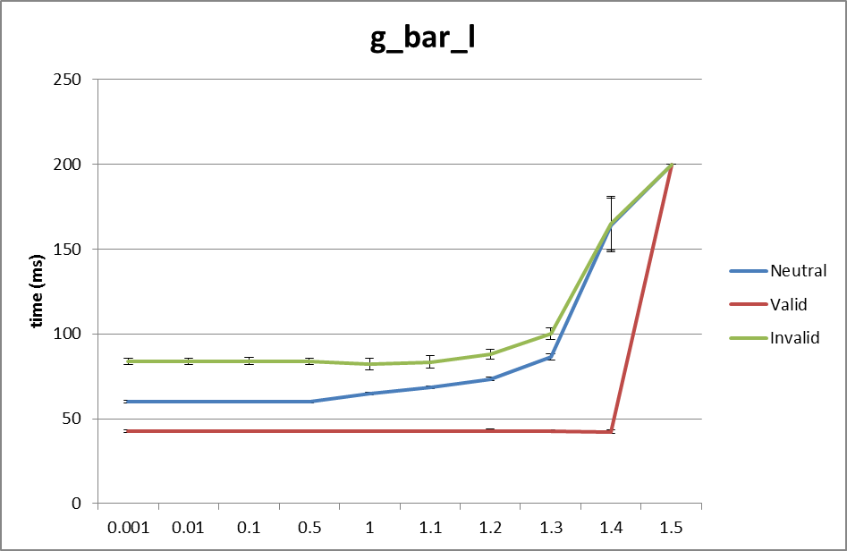
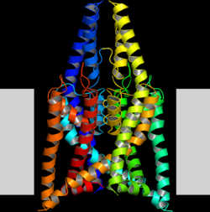
Posner: leak channels
Parameter regulating maximal conductance of leak (potassium K⁺) channels changed from 0.001 to 1.3 has relatively small influence on reaction times. Beyond this value all reaction times become much longer.
Strong leak currents decrease membrane potentials and activation of neurons takes longer time. The KCNK gene family proteins build two-pore-domain potassium leak channels, the main suspect in this case.

Slide 39
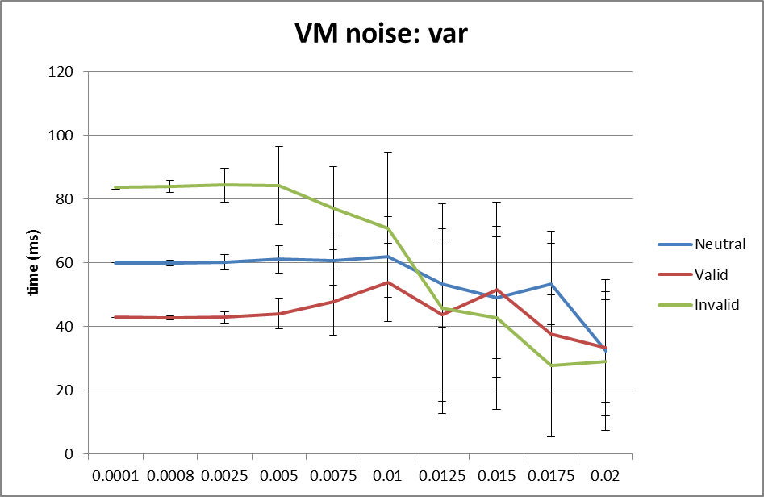
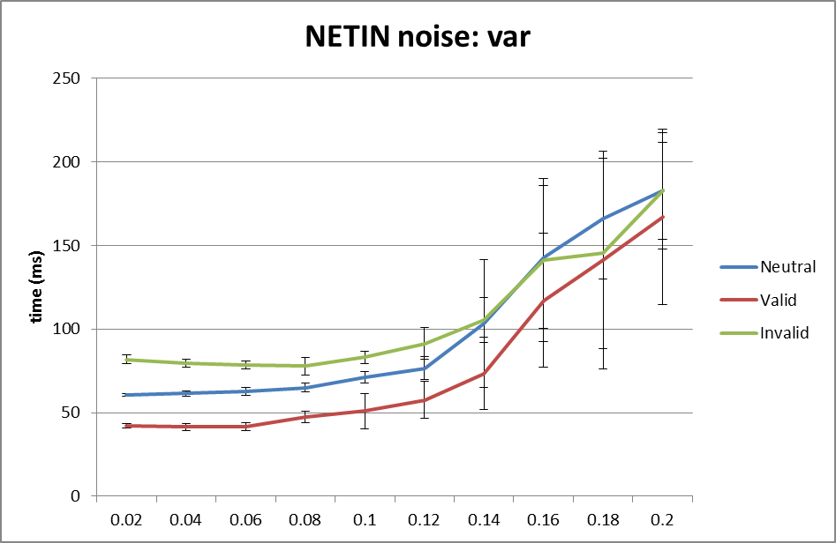
Posner: noise
Noise may be included either as the variance of the value of membrane potential, or variance of the synaptic input.
The first type of noise makes the switch from invalid cue to the target position faster, decreasing sharply the time for invalid trials and to a smaller degree also other times.
Attractors become weaker and transitions may be made faster.
Synaptic noise has the opposite effect, competition between competing patterns becomes stronger and achieving the threshold for decision takes longer. High density of synapses will contribute to the “synaptic bombardment” type of noise.

Slide 40
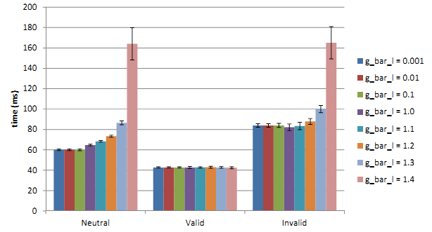
Posner spatial attention
More complex cue = stronger local attractor => can bind ASD longer?
Cue pulsating with different frequencies may create resonances?
What changes in the network will lead to faster attention shifts?
Broadening of attractor basins => helps to decrease symptoms?
Diagnostic value?
Explains fever effects?
Suggest pharmacotherapy?
Need for more accurate models.
Model in GENESIS is inconclusive.
Spatial attention shifts in Posner experiments as a function of leak channel conductance change between 20-120 ms.

Slide 41
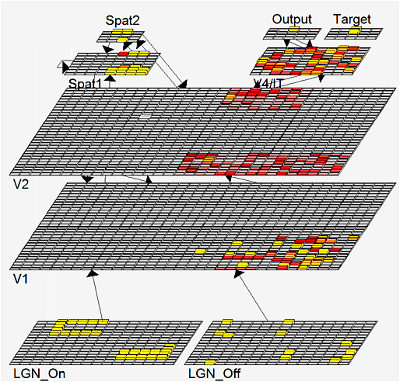
Recognition of many objects
Vision model including LGN, V1, V2, V4/IT, V5/MT
Two objects are presented.
Connectivity of these layers: Spat1 ⬄ V2, Spat 2 Spat1 ⬄ V2, Spat 2 Spat2 ⬄ V2.
Spat1 has recurrent activations and inhibition, focusing on a single object.
In normal situations neurons desynchronize and synchronize on the second object = attention shift.

Slide 42
Model of movements
Model of cyclic movements was constructed using several simple patterns representing the movement of left and right arm, hand, leg, foot, reflected as a sequence of activations in the input layer with addition of the accommodation mechanism (i.e. neural fatigue). Output layer represents activations within the motor cortex (left arm).
“Sliding attractors” are sometimes followed by irregular movements, ex. in speech, singing, gestures etc.

Slide 43
Model of reading
Spontaneous transitions.
Emergent neural simulator:
Aisa, B., Mingus, B., and O'Reilly, R. The emergent neural modeling system. Neural Networks, 2008.
3-layer model of reading:
orthography, phonology, semantics, or distribution of activity over 140 microfeatures of concepts.
Hidden layers in between.
Learning: mapping one of the 3 layers to the other two.
Fluctuations around final configuration = attractors representing concepts.
How to analyze properties of attractor basins, their relations?

Slide 44
Fuzzy Symbolic Dynamics (FSD)
Trajectory of dynamical system (neural activities), using recurrent plots (RP):
RP plots S(t,t₀) values as a matrix.
FSD shows trajectories in 2D or 3D: find reference centers μ₁, μ₂ , μ₃ on standardized data and optimize their position to see clearly important features of trajectories despite reduced dimensionality.
This creates localized membership functions y_{k}(t;W).
Sharp indicator functions => symbolic dynamics; x(t) => strings of symbols.
Soft membership functions => fuzzy symbolic dynamics, dimensionality reduction Y(t)=(y₁(t;W), y₂(t;W)) => visualization of high-D data.
Dobosz K, Duch W, Neural Networks 23, 487-496, 2010; Cognitive Neurodynamics 5(2), 145-160, 2011

Slide 45
PDP: Prototype Distance Plots
If 3 D is not sufficient show distances of the trajectories to more reference points: color = distance, horizontal axis = time, vertical axis: prototypes.
40 reference points, trajectory starts from attractor for the “flag” word, then goes close to some concrete word patterns, but rather far from abstract patterns.

Slide 46
Attractors for words
Model for reading includes phonological, orthographic and semantic layers with hidden layers in between.
FSD/RP visualization of activity of the semantic layer with 140 units.
Cost and rent have semantic associations, attractors are close to each other, but without noise or accommodation transitions between basins of attractions are hard.
Will these relations show up in verbal priming tests? Free associations?
Will broadening of phonological/written form representations help?
For example, will training ASD children with characters that vary in many ways (shapes, colors, size, rotations) help them to form broader categories?

Slide 47
Neurodynamics
Trajectories show spontaneous attention shifts that emerge as a property of neurodynamics, and depends on:
synaptic connections: local connectivity, inhibitory competition, bidirectional inter/intralayer processing, multiple constraint satisfaction …
neural properties: thresholds, accommodation, exc/inh/leak conductance …
Input activations: transients => basins of attractors => object recognition
Normal case: relatively large basins, generalization, average dwell time, moving to other basin of attraction, exploring the activation space.
Without accommodation (inactive outward rectifying ion channels): deep, narrow basins, hard to move out of the basin, associations are weak.
Accommodation: basins of attractors shrink and vanish because neurons desynchronize due to the neural fatigue. This allows other neurons to synchronize on new stimuli, guided by Spat => V2 => V1 feedback.
This leads to sudden spontaneous weakly related chains of thoughts.

Slide 48
Recurrence plots
Starting from the word “flag”, with small synaptic noise (var=0.02), the network starts from reaching an attractor and moves to another one (frequently quite distant), creating a “chain of thoughts”.
Same trajectories displayed with recurrence plots, showing roughly 5 larger basins of attractors and some transient points.

Slide 49
How strong are attractors?
Variance around the center of a cluster grows with synaptic noise; for narrow and deep attractors it will grow slowly, for wide basins it will grow fast.
Jumping out of the attractor basin reduces the variance due to inhibition of desynchronized neurons.
More varied encoding of concrete nouns seems to help creating larger attractor basins. Abstract concepts show narrow and deep basins, variance is small and suddenly increases.

Slide 50
Probability of recurrence
Probability of recurrence may be computed from recurrence plots, or from clusterization of trajectory points, allowing for evaluation how strongly some basins of attractors capture neurodynamics.

Slide 51
Fast transitions
Attention is focused only for a brief time and than moved to the next attractor basin, some basins are visited for such a short time that no action may follow, no chance for other neuronal groups to synchronize. This corresponds to the feeling of confusion, not being conscious of fleeting thoughts.

Slide 52
Normal-Autism
All plots for the flag word, different values of b_inc_dt parameter in the accommodation mechanism. b_inc_dt = 0.01 & b_inc_dt = 0.005
b_inc_dt = time constant for increases in intracellular calcium building up slowly as a function of activation, controls voltage-dependent leak channels.
http://kdobosz.wikidot.com/dyslexia-accommodation-parameters

Slide 53
Normal-ADHD
All plots for the flag word, different values of b_inc_dt parameter in the accommodation mechanism. b_inc_dt = 0.01 & b_inc_dt = 0.02
b_inc_dt = time constant for increases in intracellular calcium which builds up slowly as a function of activation.
http://kdobosz.wikidot.com/dyslexia-accommodation-parameters

Slide 54
Inhibition
Increasing g_{i} from 0.9 to 1.1 reduces the attractor basin sizes and simplifies trajectories.
Strong inhibition,
empty head …

Slide 55
Connectivity: strong reccurence
With small synaptic noise (var=0.02) the network starts from reaching an attractor and moves to another one (frequently quite distant), creating a “chain of thoughts”.
Same situation, with stronger recurrent connections within layers; fewer but larger attractor basins are created, and more time is spent in each basin.

Slide 56
Some speculations
Attention shifts may be impaired due to several factors:
Deep and narrow attractors that entrap dynamics – due to leak channels?
Explains overspecific memory in ASD, unusual attention to details, the inability to generalize visual and other stimuli but not olfactory.
Shallow and broad attractors: ADHD short attention span, need for psychostimulants to stablize ADHD.
Accommodation: voltage-dependent K⁺ channels (~40 types) do not decrease depolarization in a normal way, attractors do not shrink.
This effect should also slow down attention shifts and reduce jumps to unrelated thoughts or topics relatively to average person – neural fatigue will temporarily switch them off preventing activation of attractors that code significantly overlapping concepts.
What behavioral changes are expected? How to tests it?

Slide 57
Learning connectome styles
Simple connectome models may help to connect and improve learning classification of the styles.
S, Sensory level, occipital, STS, and somatosensory cortex;
C, central associative level, abstract concepts that have no sensory components,
M=Motor
C=Central
World
S=Sensory
mostly parietal, temporal and prefrontal lobes;
M, motor cortex, motor imagery & physical action. Frontal cortex, basal ganglia.
Even without emotion and reward system predominance of activity within or between these areas explains many learning phenomena.
Look-up table algorithms: Qian N, Lipkin RM. A learning-style theory for understanding autistic behaviors. Frontiers of Human Neuroscience 2011.

Slide 58
Learning styles 1st D
Kolb perception-abstraction: coupling within sensory S⬄S areas, vs. coupling within central C⬄C areas.
Strong C=>S leads to vivid imagery dominated by sensory experience.
Autism: vivid detailed imagery, no generalization. Cows will panic if they enter barn … (Temple Grandin).
M=Motor
C=Central
World
S=Sensory
Attention = synchronization of neurons, limited to S, perception S⬄S strongly binds attention, no chance for normal development. Asperger syndrome strong C=>S activates sensory cortices preventing understanding of metaphoric language.
If central C⬄C processes dominate, no vivid imagery but efficient abstract thinking is expected: mathematicians, logicians, theoretical physicist, theologians and philosophers ideas.

Slide 59
Geometric model of mind
Objective ⬄ Subjective.
Brain ⬄ Mind.
Neurodynamics describes state of the brain activation measured using EEG, MEG, NIRS-OT, PET, fMRI or other techniques.
How to represent mind state?
In the space based on dimensions that have subjective interpretation: intentions, emotions, qualia.
Mind state and brain state trajectory should then be linked together by transformations (BCI).
Need for neurophenomenology.

Slide 60
Research/diagnostic consequences
Many problems at genetic/molecular level may lead to the same behavioral symptoms => problems for statistically-oriented research methods.
Genetic mutation should give weak signals: in a given population of autistic patients only small fraction will have a given mutation.
Inconclusive results on diet: several studies show some improvement, other studies show no effect.
Pharmacological and other treatments will have limited success.
Need for a better diagnostics at molecular/genetic level!
Strategy: behavior <= neural properties;
find neural parameters that affect behavior in a specific way;
try to relate them to molecular properties in synapses, various receptors, ion channels (pore forming proteins), membrane properties;
try to find markers for specific abnormalities.

Slide 61
Behavioral consequences
Deep, localized attractors are formed; what are the consequences?
Problems with disengagement of attention;
hyperspecific memory for images, words, numbers, facts, movements;
strong focus on single stimulus, absorption, easy sensory overstimulation;
gaze focused on simple stimuli, not faces, contact is difficult;
echolalia, repeating words without understanding (no associations);
nouns are acquired more readily than abstract words like verbs;
play is schematic, fast changes are not noticed (stable states cannot arise);
play with other children is avoided in favor of simple toys;
generalization and associations are quite poor; integration of different modalities that requires synchronization is impaired, connections are weak;
normal development – theory of mind, MNS, relations – is impaired.
Simple basic deficit => host of problems, many insights from such mechanisms.
Expect great diversity of symptoms, depending on local expression and severity.

Slide 62
Experimental evidence: behavior
Kawakubo Y, et al. Electrophysiological abnormalities of spatial attention in adults with autism during the gap overlap task. Clinical Neurophysiology 118(7), 1464-1471, 2007.
“These results demonstrate electrophysiological abnormalities of disengagement during visuospatial attention in adults with autism which cannot be attributed to their IQs.”
“We suggest that adults with autism have deficits in attentional disengagement and the physiological substrates underlying deficits in autism and mental retardation are different.”
Landry R, Bryson SE, Impaired disengagement of attention in young children with autism. Journal of Child Psychology and Psychiatry 45(6), 1115 - 1122, 2004
“Children with autism had marked difficulty in disengaging attention. Indeed, on 20% of trials they remained fixated on the first of two competing stimuli for the entire 8-second trial duration.”
Several newer studies: Mayada Elsabbagh.

Slide 63
Experimental evidence: behavior
D.P. Kennedy, E. Redcay, and E. Courchesne,
Failing to deactivate: Resting functional abnor- malities in autism. PNAS 103, 8275-8280, 2006.
Default network in autism group failed to deactivate brain regions, strong correlation between a clinical measure of social impairment and functio- nal activity within the ventral MPF.
Mistaking symptoms for real problems: We speculate that the lack of deactivation in the autism group is indicative of abnormal internally directed processes at rest.

Slide 64
Mistaking symptoms for causes
Various brain subsystems develop in an abnormal way:
1. Abnormal functional connectivity between extra striate and temporal cortices during attribution of mental states, and executive tasks such as memory for or attention to social information (Castelli et al., 2002 ; Just et al., 2004, 2007; Kana et al., 2007a, b; Dichter et al., 2007; Kleinhans et al., 2008).
2. Underconnectivity: working memory, face processing (Just et al., 2007; Koshino et al., 2008; Bird et al., 2006), cortico-cortical connectivity (Barnea-Goraly et al., 2004; Herbert et al., 2004; Keller et al., 2007).
3. Default mode network: “Results revealed that while typically developing individuals showed enhanced recall skills for negative relative to positive and neutral pictures, individuals with ASD recalled the neutral pictures as well as the emotional ones. Findings of this study thus point to reduced influence of emotion on memory processes in ASD than in typically developing individuals, possibly owing to amygdala dysfunctions.”
C. Deruelle et al., Negative emotion does not enhance recall skills in adults with autistic spectrum disorders. Autism Research 1(2), 91–96, 2008

Slide 65
Experimental evidence: molecular
What type of problems with neurons create these types of effects?
Neural self-regulation mechanisms lead to fatigue or accommodation of neurons through leaky K⁺ channels opened by high Ca⁺⁺ concentration, or longer acting GABA-B inhibitory synaptic channel.
This leads to inhibition of neurons that require stronger activation to fire.
Neurons accommodate or fatigue and become less and less active for the same amount of excitatory input.
Dysregulated calcium signaling, mainly through voltage-gated calcium channels (VGCC) is the central molecular event that leads to pathologies of autism.
http://www.autismcalciumchannelopathy.com/
Calcium homeostasis in critical stages of development may be perturbed by genetic polymorphism related to immune function and inflammatory reactions and environmental influences (perinatal hypoxia, infectious agents, toxins).
Genetic mutations => proteins building incorrect potassium channels (CASPR2 gene) and sodium channels (SCN2A gene).

Slide 66
Genes & functions
http://www.sciencebasedmedicine.org/?p=5662
Pinto, D. + 180 coauthors ... (2010). Functional impact of global rare copy number variation in autism spectrum disorders Nature DOI: 10.1038/nature09146

Slide 67
Questions/Ideas
Neurodynamics is a new useful language to speak about mental processes.
There are many parameters characterizing biophysical properties of neurons and their connections within different layers that control behavior.
How does depth/size of basins of attractors depend on these parameters?
How to measure and/or visualize attractors?
How do attractors depend on the dynamics of neuron accommodation? Noise? Inhibition strength, local excitations, long-distance synchronization?
Stability of more detailed neural models, real effects or artifacts?
How will symptoms differ depending on specific brain areas? For example, mu suppression may be due to deep attractors …
What are precise relations to ion channels and proteins that build them?
How can they be changed by pharmacological interventions?

Slide 68
More questions/ideas
How learning procedures may influence formation of basins of attractors? For example, learning to read may depend on the variability of fonts, handwriting may be much more difficult etc.
Slow broadening of attractor basins?
Spontaneous thoughts, local energy with low neural accommodation?
Can one draw useful suggestions how to compensate for such deficits?
Spatial attention shifts in Posner experiments – resonances depending on the timing, masking effects, flickering with different frequencies?
Precise diagnostics, what type of problems at genetic/molecular level?
Compensation effects: what changes in the network will lead to faster attention shifts?
Will it help in diagnostics/therapy? Neurofeedback? We need to finish computational simulations and then do real test of some predictions.

Slide 69
4 CS conferences in 2013: Homo communicativus,
Neuromania, and Neurohistory of art in May/June 2013; Trends in interdisciplinary studies 8-10.11.2013 http://www.kognitywistyka.umk.pl

Slide 70
Thank you for synchronizing your neurons!
Google: W. Duch => papers, talks, lecture notes …

