Slide 1


Brains: the ultimate challenge for complex systems
Włodzisław Duch
Department of Informatics,
Nicolaus Copernicus University, Toruń, Poland
School of Computer Engineering,
Nanyang Technological University, Singapore
Google: Duch W
NTU SPMS/9-2011

Slide 2
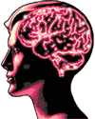
INT?
All things neuro … but no center of competence in Singapore.
Institute for Neurocognitive Technologies (INT)
All things related to brains
Large-scale projects in the world
Our efforts at NTU so far
Some ideas and results
Why it is worthwhile, will it be done and why it will change everything!
I started from physics, but one should judge a men not by how he starts, but how he finishes …

Slide 3
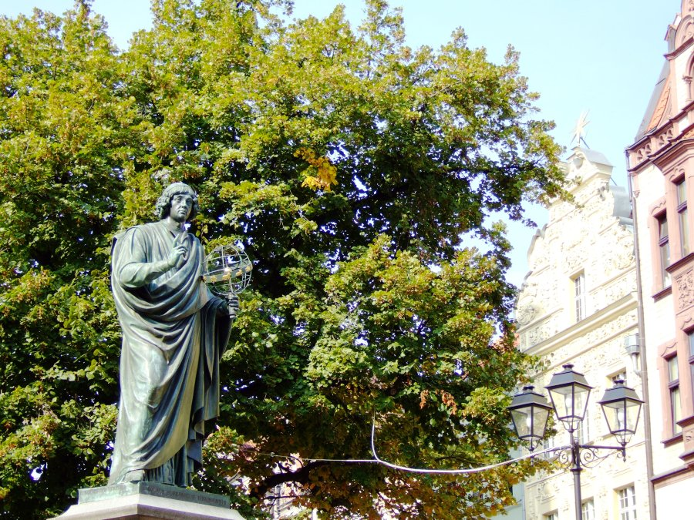
Toruń
Nicolaus Copernicus: born in 1473 in Toruń

Slide 4
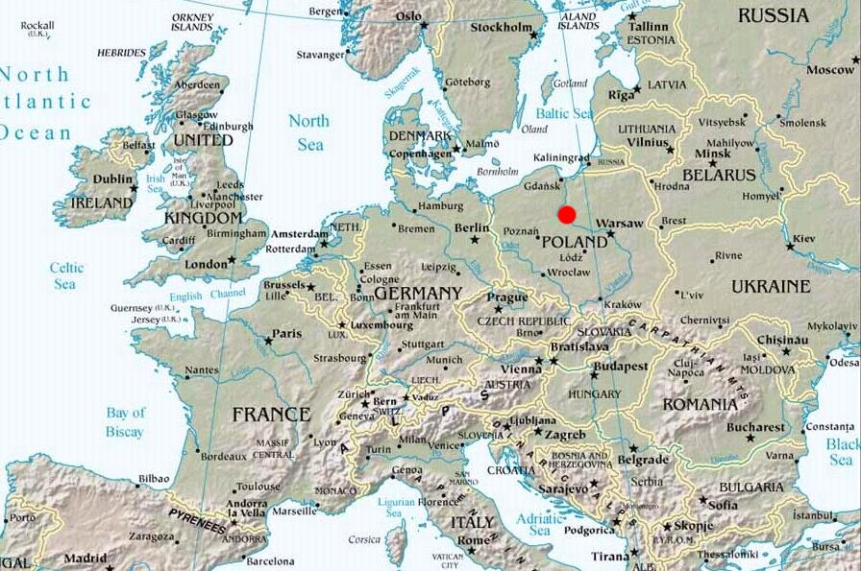
Toruń

Slide 5

DI NCU Projects: CI
Google W. Duch => List of projects, talks, papers
Computational intelligence (CI), main themes:
Foundations of computational intelligence: transformation based learning, k-separability, learning hard boole’an problems.
Meta-learning, or learning how to learn.
Understanding of data: prototype-based rules, visualization.
Novel learning: projection pursuit networks, QPC (Quality of Projected Clusters), search-based neural training, transfer learning or learning from others (ULM), aRPM, SFM ...
Similarity based framework for metalearning, heterogeneous systems, new transfer functions for neural networks.
Feature selection, extraction, creation.

Slide 6

DI NCU Projects:NCI
Neurocognitive Informatics projects.
Computational creativity, insight, intuition, consciousness.
Neurocognitive approach to language, word games.
Medical information retrieval, analysis, visualization.
Global analysis of EEG, visualization of high-D trajectories.
Brain stem models and consciousness in artificial systems.
Autism, ADHD, phenomics, comprehensive theory.
Imagery agnosia, especially imagery amusia.
Infants: observation, guided development.
Integration of Humanized Interface Technologies (HIT).
Free will, neural determinism and social consequences.

Slide 7
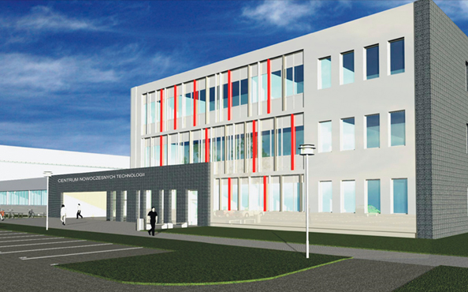
Interdisciplinary Center of
Innovative Technologies
Why am I interested in this?
ICIT in construction,
working - end of 2012.
Neurocognitive lab,
5 rooms, many
projects requiring experiments.
Funding: national/EU grants
Understanding brain plasticity, mind states.

Slide 8
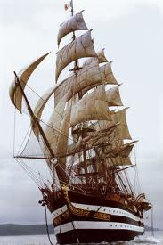
EU FP7 FET Flagships I
6 candidates for FET (Future Emerging Technologies)
Flagships Projects, each a 10 year 1 billion EUR programs,
in preparatory phase.
2 projects will be selected in 2012.
FuturICT: Knowledge Accelerator and Crisis-Relief System: Unleashing the Power of Information for a Sustainable Future.
What if global scale computing facilities were available that could analyse most of the data available in the world?
ITFoM: The IT Future of Medicine, proposes a data-driven, individualised medicine of the future, based on the molecular/physiological/anatomical data from individual patients. ITFoM shall make general models of human pathways, tissues, diseases and ultimately of the human as a whole.
Graphene-CA: Graphene Science and technology for ICT and beyond, electronics, spintronics, photonics, plasmonics and mechanics.

Slide 9
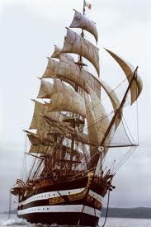
FET Flagships II
HBP-PS: The Human Brain Project, understanding the way
the human brain works could be key to enabling a whole
range of brain related or inspired developments in
Information and Communication Technologies, as well as
having transformational implications for neuroscience and medicine.
CA-RoboCom: Robot Companions for Citizens are soft skinned and sentient machines designed to deliver assistance to people. This assistance is defined in the broadest possible sense and covers all sorts of different settings. Based on multidisciplinary science and engineering, CA-RoboCom aims to develop a radically new approach towards machines and how these are deployed in society.
Guardian Angels: Guardian Angels for a Smarter Planet.
Providing Information and Communication Technologies to assist people in all sorts of complex situations is the long term goal of the Flagship Initiative, Guardian Angels.

Slide 10
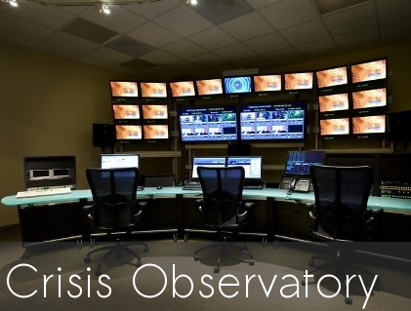
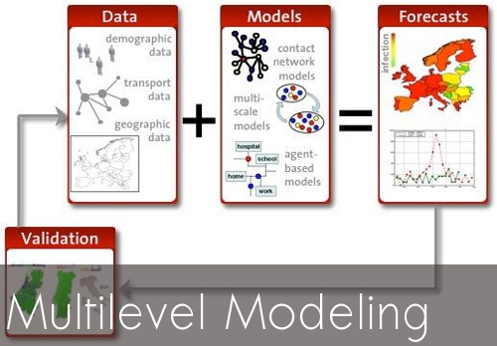
FuturICT
The FuturICT flagship proposal intends to unify hundreds of the best scientists in Europe to explore social life on earth and everything it relates to.
The FuturICT flagship proposal will produce historic breakthroughs and provide powerful new ways to manage challenges that make the modern world so difficult to predict, including the financial crisis.
A bit like Cybersyn project in Chile (1970-73) in real-time cybernetics control of economy.

Slide 11

Blue Brain/HBP
The Blue Brain project proposed models at many levels of complexity.
1. The Blue Synapse: A molecular level model of a single synapse.
2. The Blue Neuron: A molecular level model of a single neuron.
3. The Blue Column: A cellular level model of the Neocortical column with 10K neurons, later 50K, 100M connections (completed 2008).
4. The Blue Neocortex: A simplified Blue Column will be duplicated to produce Neocortical regions and eventually and entire Neocortex.
5. The Human Brain Project will build models of other cortical and subcortical models of the brain, the sensory + motor organs, and the whole brain.
Blue Gene simulates ~100M minimal compartment neurons or 10-50K multi-compartmental neurons, with 10³-10⁴ x more synapses.
Next generation HBP will simulate >10⁹ neurons with significant complexity.
Great expectations for the whole brain simulations?
A lot of neuroscience has to be done first to know what to model!

Slide 12
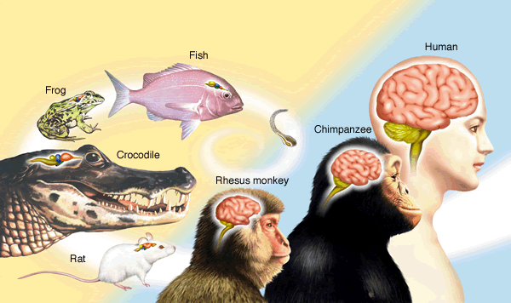
How complex are brains?
Human: mass ~1.4 kg, protein is 130 g, fats 100 g, the rest is water.
2% of body mass, using 20% of oxygen, 25% glucose, about 20-25 Watt.
About 40G neurons (30G in cerebellum), with ~10¹⁴ (100 T) connections.
Naïve estimation: memory 100 T*10 bit/synapse = 1 Petabit.
Speed: < 100 Hz * 100T = 10 Pflops; usually only 1% of neurons γ-active.
Cockroach, bee: 1 M neurons, over 1G connections, highly specialized.

Slide 13
Space/time scales
10⁻⁴ m Neurons 10⁻³ s
10⁻⁶ m Synapses 10⁻⁴ s
10⁻¹⁰ m Molecules 10⁻¹⁰ s
10⁻³ m Microcircuits 10⁻² s
10⁻² m Maps 10⁻¹ s
0.1 m Brain systems 1 s
CNS/ANS/PNS
1 m, 0.1-10 s
10⁻⁸ m Ion channel 10⁻³ s
Spatiotemporal resolution:
spatial scale: 10 orders of magnitude, from 10⁻¹⁰ m to 1 m.
temporal scale: 10 or more orders of magnitude, from 10⁻¹⁰ s to 1 s.
Architecture:
hierarchical and modular
ordered in large scale, chaotic in small;
specific projections: interacting regions wired to each other;
diffused: regions interact through hormones and neurotransmitters;
functional:
subnetworks dedicated to specific tasks.

Slide 14



Brains are overwhelming …
Annual Meeting of the Society of Neuroscience, 25-30.000 people, more than half presenting papers … Principles of Neural Science textbook (Kandel, Schwartz, Jessell) had over 1400 pages in 2000 ….
Molecular Neuroscience: molecular biology, molecular genetics, neurochemistry, proteomics, signaling pathways, metabolomics, phenomics and other “omics”,neuroendocrinology, neuro(psycho)pharmacology, neuroimmunology ...
Cellular Neuroscience: morphology and physiological properties of neurons and glia cells at a cellular level, neuron receptors, ion channels, neuron membranes, axon structures, generation of action potentials, brain plasticity (learning) …
Developmental Neuroscience: stem cells and neural differentiation, neural growth and migration, synapse formation, apoptosis, embryonic brain development, neurodevelopmental disorders, evolutionary developmental biology (evo-devo), Baldwin effect, animal models …

Slide 15



more overwhelming …
Systems neuroscience: motor system and sensory systems neuroscience, early perception, types of sensory receptors (chemo, electro, mechano, visual), sensory fibers/nerves, specific functions, affective neuroscience ..
Neuroanatomy: comparative neuroanatomy, brain regions, microcircuits, connectomics at different levels…
Clinical neuroscience: disease and disorders, neurology, neuropsychiatry, neurodegeneration, movement disorders, neurodevelopmental disorders, addictions, clinical neurophysiology, neurovirology, psychiatric genetics, neurocardiology, neurooncology, neuroradiology, neurogastroenterology, neuroendocrinology, neuro-ophthalmology, neuropathology, pain, neuroepidemiology, neurosurgery, neurointensive care …
Behavioral Neuroscience: or biological psychology, biopsychology, or psychobiology: behavior as a function of genetic, physiological, and developmental processes, chronobiology, motivations, drives, emotions, language, volition, decisions, reasoning, consciousness.

Slide 16
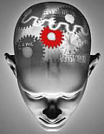
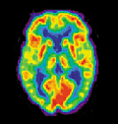
and more overwhelming …
Neuropsychology: psychological effects of neural activity, close to experimental and behavioral psychology, clinical psychology, psychoterapy, neuro-psychoanalysis, neurophenomenology.
Social neuroscience: neurosociology, neuroeconomics, neuropolitics, neuromarketing, neuroeducation, neuroergonomics, neuroethics, neurolaw, neuroanthropology and neuroculture, neuroesthetics, neurotheology, neurophilosophy …
Neuroengineering: sensory substitution, sensory enhancement, neuroprosthetics, brain–computer interfaces, neurorobotics, …
Neuroimaging (EEG, MEG, MRI, FMRI, PET, NIRS, SPECT …) and
brain stimulation (TMS, current flows).
Computational Neuroscience: cognitive neurodynamics, human cognome project, neurophysics, neurocognitive informatics.

Slide 17
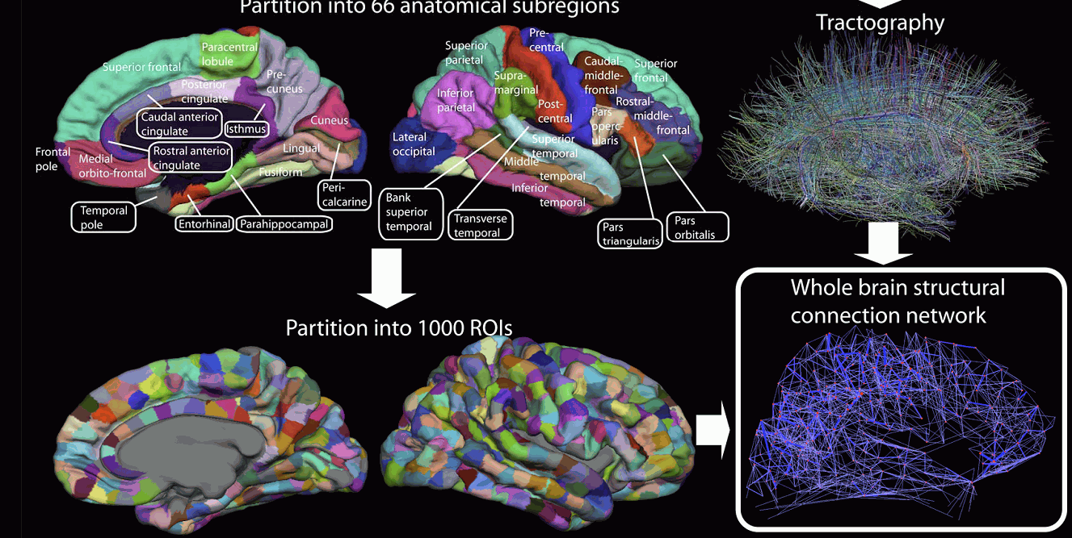
Connectome Project
We do not know all details of information flow, the human connectome project should construct maps of structural and functional neural connections.
But rough connectivity is already known. Check this gallery of the HCP.

Slide 18
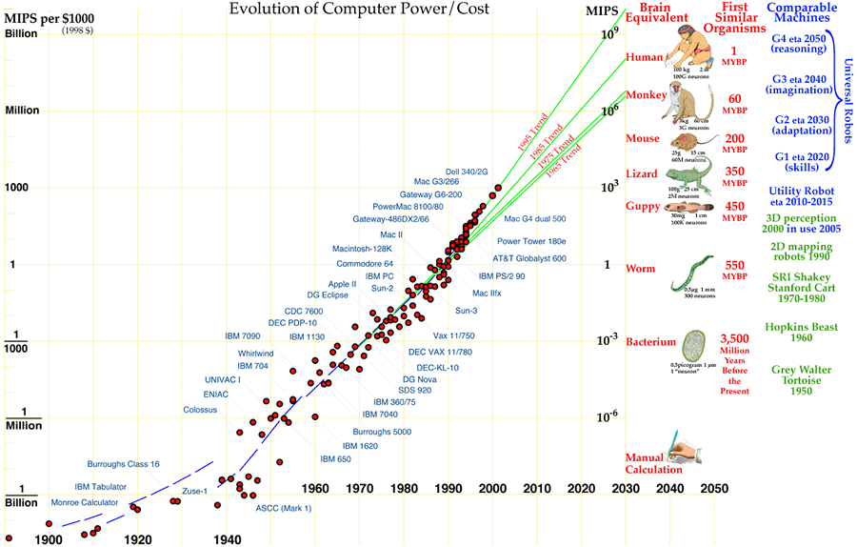
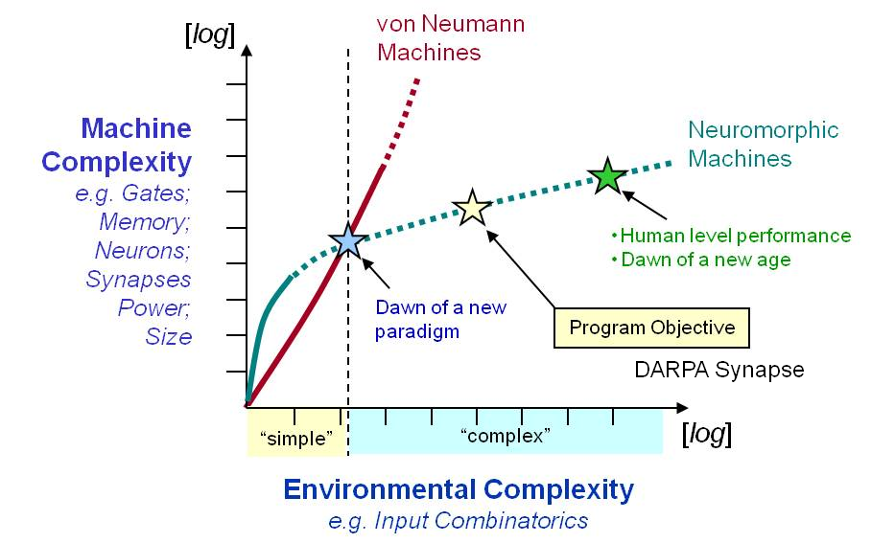
Brains and computers

Slide 19
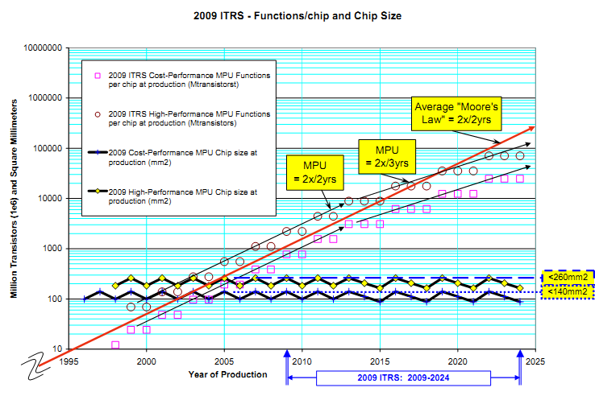
Microprocessor complexity
2009 Int. Technology Roadmap for Semiconductors: MPU Product Functions/Chip and Industry Average “Moore’s Law” and Chip Size Trends

Slide 20
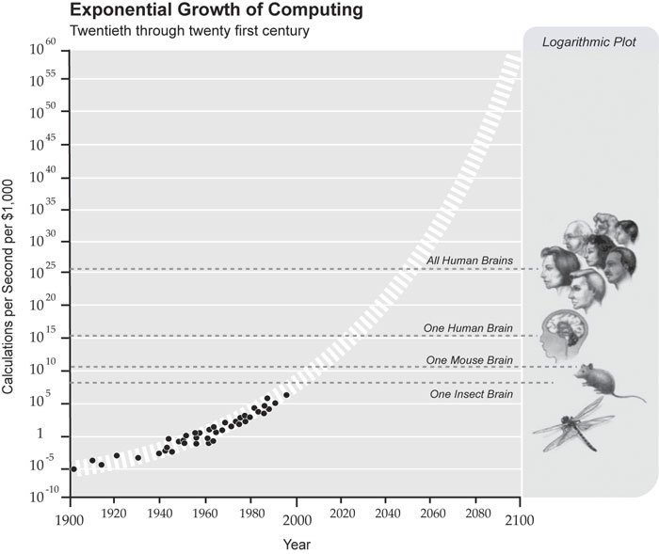
Exponential growth of power
From
R. Kurzweil,
The Law of Accelerating Returns
By 2020 PC computers
will match the raw speed of brain operations!
What about organization of info flow?

Slide 21
Brains and computers
Can we handle such complexity?
IBM Blue Gene, 2048 processors, needs 80 min. to simulate 1 sec. of activity of V1 cortex covering 9º field, 5000 x slower than real time.
Intel: 80 cores, 1 Teraflop in a PC; CUDA and GPUs with similar speed, but classical computer architectures are not well suited.
Neuromorphic approach: analog hardware neurons.
Neurogrid (Kwabena Boahen, Bioengineering, Stanford 2007): analogue neuromorphic supercomputer on our desktop? Low power, spiking.
A human brain emulation race is starting?
DARPA Systems of Neuromorphic Adaptive Plastic Scalable Electronics (SyNAPSE) program: develop biological-scale neuromorphic electronic systems for human scale brain emulation by 2019.
Europe 1GE human brain emulation project with a target for 2024.

Slide 22

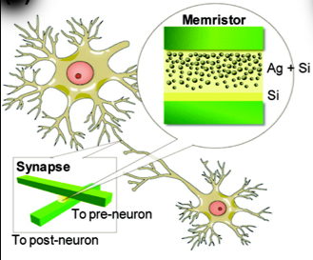
Brains from nanostructures
SyNAPSE: Systems of Neuromorphic Adaptive Plastic Scalable Electronics.
Develop electronic neuromorphic machine technology that scales to biological levels.
IBM Research (Almaden) is coordinator,
HRL Laboratories (HRL), Hewlett-Packard + Cornell, Columbia, Stanford, Wisconsin-Madison, UC Merced Universities with many subcontractors.
So far DARPA gave over 40 million $ to the project, now (2011) in phase 2.
Brain-like chips define a fundamentally distinct form of computational device.

Slide 23
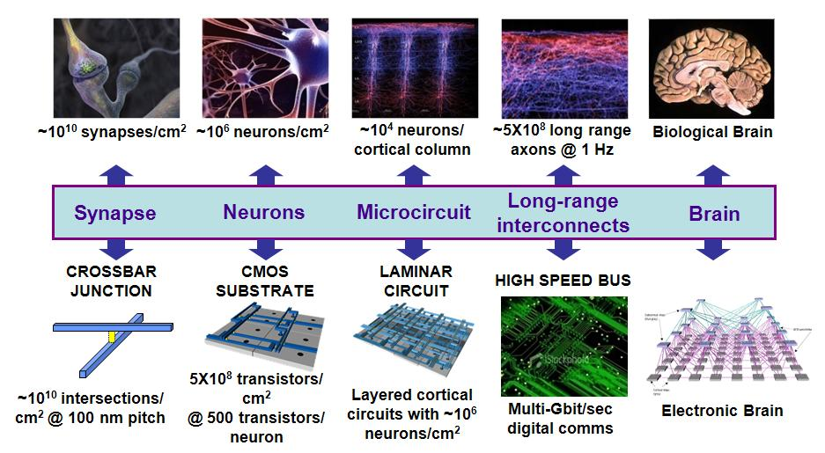
From brains to machines
Source: DARPA Synapse project

Slide 24
Program Outline
Phase 0
Phase 1
Phase 2
Phase 3
Phase 4
Component synapse (and neuron) development
CMOS process and core circuit development
~10⁶ neuron single chip implementation “Mouse” level
~10⁸ neuron multi-chip robot at “Cat” level
Hardware
CMOS process integration
Microcircuit architecture development
System level architecture development
~10⁶ neuron design for simulation and hardware layout
~10⁸ neuron design for simulation and hardware layout
Architecture
& Tools
Comprehensive design capability
Simulate large neural subsystem dynamics
“Mouse” level benchmark
(~ 10⁶ neuron)
“Cat” level benchmark
(~ 10⁸ neuron)
Emulation
& Simulation
Preparatory studies only
Build Sensory, Planning and Navigation environments
“Small mammal” complexity
Add Audition, Proprioception and Survival
“All mammal” complexity
Preparatory studies only
Add Touch and Symbolic environments
Environment
Sustain
Program Phases 1-4 may be combined per the BAA instructions

Slide 25
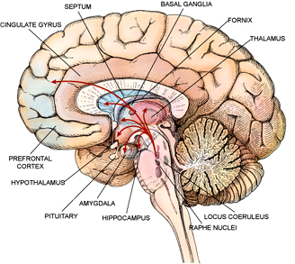
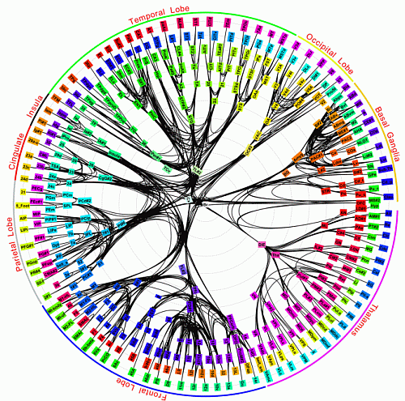
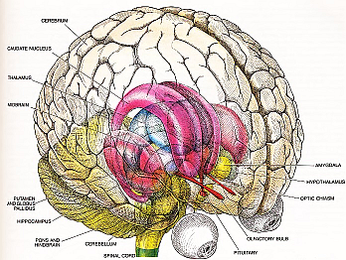
Modules: core brain
Connectivity of 383 regions in macaque brain; Modha & Singh, PNAS 2010.

Slide 26

Principles: time & structure
S.J. Kiebel, J. Daunizeau, K.J. Friston, A Hierarchy of Time-Scales
and the Brain. PLoS Computational Biology, Vol 4 (11), 2008, e1000209
Free energy principle: adaptive agents (brains) in a dynamic environment minimize their surprise about sensory input => predictive brain, learning regularities in the environment from exposure to sensory input and internally generated signals => slow feature analysis, deep learning.
Brains model entire environment as a collection of hierarchical, dynamical systems (first step: correlation or Hebbian learning).
Slower environmental changes provide the context for faster changes.
There is a simple mapping between this temporal hierarchy and the anatomical hierarchy of the brain.
Explains a wide range of neuroscientific findings by optimization of value.
Reaction time ~ 100 ms is a compromise between the need for fast reaction and brain power needed for planning/perception.

Slide 27
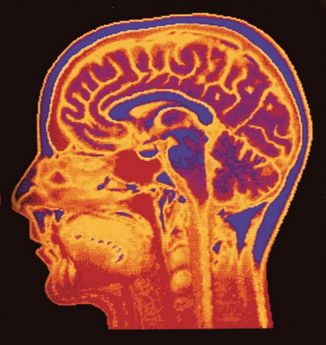
Understanding by creating brains
“Here, we aim to understand the brain to the extent that we can make humanoid robots solve tasks typically solved by the human brain by essentially the same principles. I postulate that this ‘Understanding the Brain by Creating the Brain’ approach is the only way to fully understand neural mechanisms in a rigorous sense.”
M. Kawato, From ‘Understanding the Brain by Creating the Brain’ towards manipulative neuroscience.
Phil. Trans. R. Soc. B 27 June 2008 vol. 363 no. 1500, pp. 2201-2214
Humanoid robot may be used for exploring and examining neuroscience theories about human brain.
Engineering goal: build artificial devices at the brain level of competence.

Slide 28
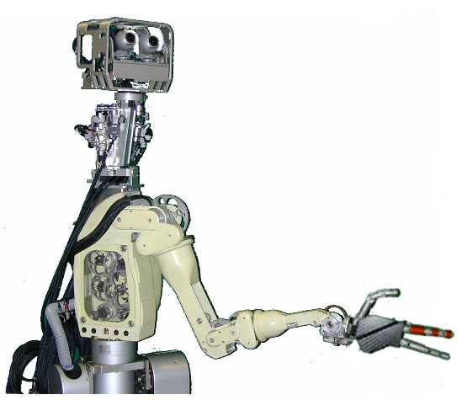
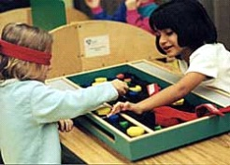
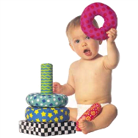
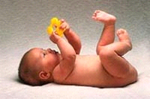
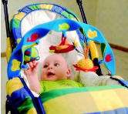
Neuro-Robotics: using robots to investigate the brain
EU IST-FET PALOMA Project – developmental approach
Validating a step-wise learning theory for grasping and manipulation
Retina-like
Vision system: 2 cameras
learning of reach and
5 primitive learning steps
learning of reach and
grasp of various objects
grasp of various objects
with subsequent
with subsequent
manipulation (
manipulation (
PMv
PMv
)
learning of reach,
)
learning of reach,
grasp and
Anthropomorphic neck & head:
7 d.o.f
7 proprioceptive sensors
grasp and
manipulation for
manipulation for
simple objects
simple objects
(
(
PMd
PMd
)
)
learning of
learning of
goal directed
goal directed
sequences
sequences
(PT)
learning of a
(PT)
learning of a
multimodal
multimodal
representation of
representation of
hand movement
hand movement
(PP)
(PP)
learning of the
learning of the
sensory effects of
sensory effects of
motor commands
motor commands
Age
(S1,M1)
(S1,M1)
Biomechatronic hand:
10 d.o.f
16 proprioceptive sensors
135 tactile sensors
Cog MIT 1993-2003
Anthropomorphic robot arm: 8 dof,
16 (8+8) proprioceptive sensors

Slide 29

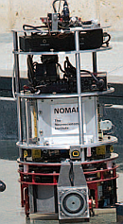
Brain-inspired architectures
G. Edelman (Neurosciences Institute) & collaborators, created a series
of Darwin automata, brain-based devices (BBD): “physical devices
whose behavior is controlled by a simulated nervous system”.
The device must engage in a behavioral task.
The device’s behavior must be controlled by a simulated
nervous system having a design that reflects the brain’s
architecture and dynamics.
The device’s behavior is modified by a reward or value system
that signals the salience of environmental cues to its nervous system.
The device must be situated in the real world.
Darwin ( (1981), Darwin VII (2002) consists of: a mobile base equipped with a CCD camera and IR sensor for vision, microphones for hearing, conductivity sensors for taste, and effectors for movement of its base, of its head, and of a gripping manipulator having one degree-of-freedom; 53K mean firing +phase neurons, 1.7 M synapses, 28 brain areas. In 2009 Darwin XII for navigation.

Slide 30
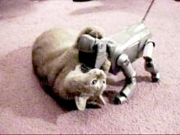
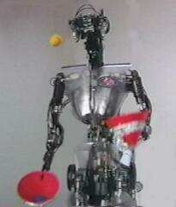
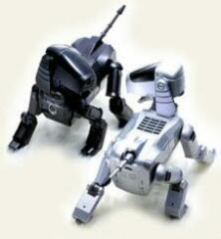
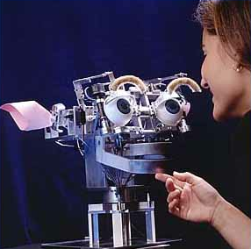
Cognitive robotics & complex devices
Robots need artificial minds, cognitive and affective control.
In fact all complex devices need artificial minds to communicate with us effectively. Smart phones will soon have hundreds of functions, but the complexity of their use should be hidden from us.
Human-Computer Interaction becomes central engineering problem.

Slide 31
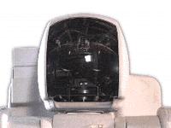
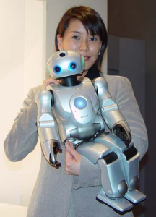
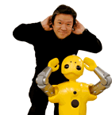
Humanoid robotics
Robots need artificial minds, cognitive and affective control. Toys – AIBO family is quite advanced, over 100 words, face/voice recognition, 6 weeks to rise, self-charging.
Most advanced humanoid robots:
Sony Qrio, standing-up, dancing, running, directing orchestra …
Honda P3 Honda Asimo
Mistsubishi-heavy Wakamaru, first commercially
sold “communication” household robot (Sept 2005)!
Wakamaru: recognizes faces, orients itself towards people and greets them, recognizes 10.000 words but does not understand much.
Qrio: Predicts its next movement in real time, shifts center of gravity in anticipation, very complex motor control, but little cognitive functions.
Artificial minds in robots and complex devices are still a dream …

Slide 32
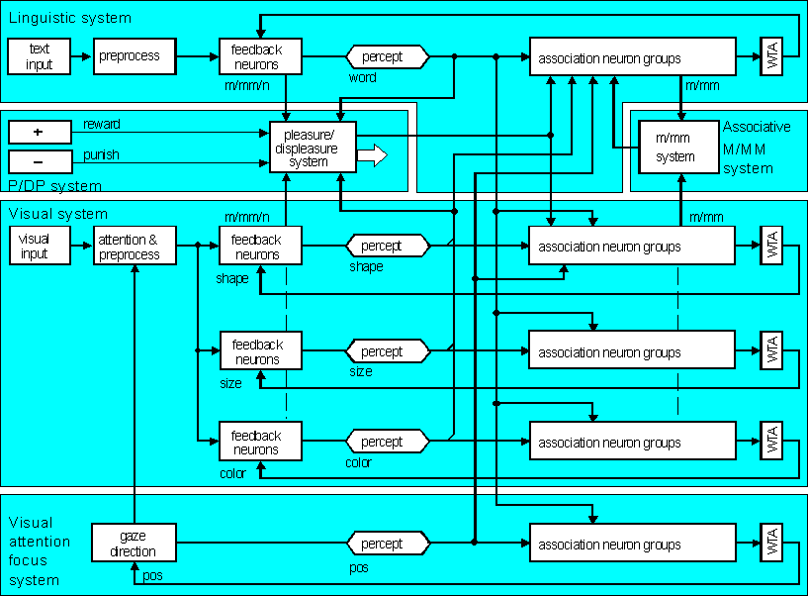
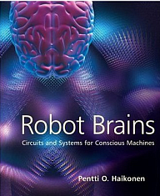
Conscious machines?
Haikonen has done some simulations based on a rather straightforward design, with neural models feeding the sensory information (with WTA associative memory) into the associative “working memory” circuits.
An associative neural processing based brain inspired computational platform, FP7 ICT Call 6 Proposal, FET Proactive. Coordinated by VTT (Finland)+7 partners

Slide 33
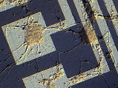
The Great Artificial Brain Race
BLUE BRAIN, HBP: École Polytechnique Fédérale de Lausanne, in Switzerland, use an IBM supercomputer to simulate minicolumn.
C2: 2009 IBM Almaden built a cortical simulator on Dawn, a Blue Gene/P supercomputer at Lawrence Livermore National Lab. C2 simulator re-creates 10⁹ neurons connected by 10¹³ synapses, small mammal brain.
NEUROGRID: Stanford (K. Boahen), developing chip for ~ 10⁶ neurons and ~ 10¹⁰ synapses, aiming at artificial retinas for the blind.
IFAT 4G: Johns Hopkins Uni (R.Etienne-Cummings) Integrate and Fire Array Transceiver, over 60K neurons with 120M connections, visual cortex model.
Brain Corporation: San Diego (E. Izhakievich), neuromorphic vision.
BRAINSCALES: EU neuromorphic chip project, FACETS, Fast Analog Computing with Emergent Transient States, now BrainScaleS, complex neuron model ~16K synaptic inputs/neuron, integrated closed loop network-of-networks mimicking a distributed hierarchy of sensory, decision and motor cortical areas, linking perception to action.

Slide 34
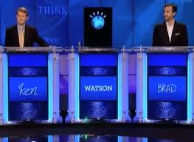
The Great AI Race
1995: Chinook wins with world champion in checkers,
and in 2007 checkers declared as provably solved.
1995: Logistello wins with Othello world champion 6 to 0!
1997: Deep Blue wins with Kasparov in chess.
Many other games have been won. Go is still a challenge: best programs achieve 4-5 dan, and need 7 stones handicap to win.
2011: IBM Watson won in Jeopardy 77K$, top human expert Ken 24K$, Brad 22K$. Answers were 85-95% correct, questions are non-trivial for humans and need extensive knowledge, understanding speech and text, reasoning using 100 NLP algorithms, machine learning techniques and lots of computing power: IBM - Blue Gene/P, 15 TB RAM, 2,880 cores, 80 Tflop.
2011, June: Nevada legalized driverless cars (Google cars)!
2011: IEEE CIS Task Force “Towards Human-like Intelligence”, new group run by Jacek Mandziuk & Wlodek Duch, just approved, has already 70 members, please join us!

Slide 35
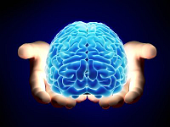

Brains and Singapore
No center of competence related to various brain-related
and brain-inspired technologies.
NNI, The National Neuroscience Institute (NNI), created in 1999 is involved only in clinical neuroscience, training neurologists, conducting basic and clinical neuroscience research.
Need for a comprehensive program to build competence in this area.
High complexity and risk, rocket science, but imagine consequences …
Understanding the brain: research on creativity and imagery, understanding trust and deception, understanding ourselves.
Protecting & Maintaining: infant development, aging assistive technologies, neuroplasticity, neurorehabilitation …
Building: Artificial Brains, HBP, Neurorobotics, robot companions
Interacting Brains: BCI, social aspects, affective computing, ICTFutur
Focus on applications: medical, cognitive and autonomous robotics …
Integrate efforts: CoE + HSS + ADM + SPMS + SBS + NIE +
Collaborate: EU/USA/Japan large scale programs.

Slide 36
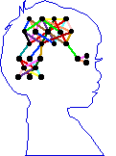
Talks and workshops
2005: First Workshop on Cognitive Systems in Singapore, organized
by the Center of Computational Intelligence (C2I), with over 100 people.
2005: SERC Cognitive Science Symposium “Building Tomorrow's Cognitive Systems”, plenary lecture “Cognitive informatics: HITs, DREAMs & Perfect Babies”, followed by discussions on the future thematic CS program.
2005: A-Star TSPRP Workshop on Cognitive Systems: Infant Development and Care (IDoCare): For happy and healthy babies; Neurocognitive Computational Framework for Emotions; Brain-inspired Visual Perception;
2006: National Institute of Education (NIE), organization of workshop on infant development (with Suzan Wright, Early childhood development).
Many talks, from 2003: Avatars, lingubots & machine consciousness;
Humanized InTerfaces, word games and cognitive robotics;
IDoCare: Infant Development and Care for development of perfect babies!” Home 2015, SHSS, NIE; Cognitive Informatics(DSTA);
Creativity, Intuition, Emotions and Perceptual Learning (SHSS);
A Neuro-Cognitive Computational Framework for Emotion.

Slide 37
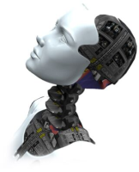
Engineering vision
1. What would be the biggest engineering achievement?
To see results of your research used by almost everyone on Earth.
2. What is it that everyone is using?
Portable phones and pilots to control TVs and other devices, getting smarter but also more complex and difficult to use every year.
3. What is the stumbling block in developing the new generation of even more useful smart phones that can do all we ask for?
Their complexity, the difficulty to use all their functions fully, the need for tedious programming, in short human-machine communication.
4. What is the solution?
Humanized InTerfaces (HITs) that would communicate with us in a natural way, ask minimum number of questions if the commands are ambiguous and do what we ask for: control household devices, help us to remember, communicate, access information and services, advice, educate, play word games ... be your guardian angel …

Slide 38
Past NTU projects I
2003: The HumanIzed Interfaces (HIT) SCE flagship project,
integration of natural perception and cognitive/affective architectures for agent-based interfaces in computers and portable devices, with applications in education, word games, assistive technologies.
2005: Brain-Inspired Model of Skill Learning: from Conscious Cognition to Subconscious Action (ARF), model of the process of gaining expertise.
2005: Brain-Inspired Car Driving (ARF).
2005: Speech and emotion-reaction modeling, analysis of emotions during car driving using different sources of information.
2005: Emovere, A Neuro-Cognitive Computational Framework for Research on Emotions, affective interactions (ARC).
2005: IDoCare: Infant Development and Care Maximizing a child’s potential” project was written for the Home 2015 Health Care SHARE initiative and has been a subject of collaboration with NIE.

Slide 39
Past NTU projects II
2006: Neurotherapy for Traumatized Children in the Disaster Areas; Neuro-Cognitive Feedback to aid Mental Diagnosis and Treatment for Post-Traumatic Stress Disorder (PTSD), games controlled by EEG for depressed/traumatized children.
2006: Developmental Robot-Embedded Artificial Mind (DREAM), cognitive architecture controlling a robotic talking head.
2007: Affective Neuro-Cognitive Learning Framework for Understanding Human Emotions. HFE pilot project
2007: Driver Profiling and Behavior Understanding: from Conscious Learning to Subconscious Actions, CRP proposal
2007: Research Center of Excellence (RCE) for Neurocognitive Informatics, a 10-year project with large budget, under the direction of W. Duch, C.T. Lin (NCTU, Taiwan), A. Ortony (NWU, USA) and A. Cichocki (BSI RIKEN, Japan), submitted to NRF. Evaluation was very positive but did not meet government expectation “someone from MIT should run such center”.

Slide 40
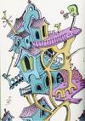
Cognitive Architectures
CA are frequently created to model human performance in
multimodal multiple task situations, rather than control cognitive systems.
Hui-Qing Chong, Ah-Hwee Tan, Gee-Wah Ng, Integrated cognitive architectu-res: a survey. Artifficial Intelligence Reviews 28:103–130, 2007; Duch W, Oentaryo R.J, Pasquier M, Cognitive architectures: where do we go from here? Frontiers in Artificial Intelligence and Applications 171, 122-136, 2008.

Slide 41
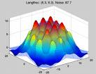
BICA as approximation
Significant progress has been made in drawing inspirations from neuroscience in analysis of perception, less in higher cognition.
For example, neurocognitive approach to linguistics has been used only to analyze linguistic phenomena, but has no influence on NLP.
“Brain pattern calculus” to approximate spreading neural activation in higher cognitive functions is urgently needed! How to do it?
Neural template matching? Network-constrained quasi-stationary waves describing global brain states Ψ(w,Cont)?
Practical algorithms to discover “pathways of the brain” has been introduced recently (Duch et al, in print) to approximate symbolic knowledge & associations stored in human brain.
Efforts to build concept descriptions from electronic dictionaries, ontologies, encyclopedias, results of collaborative projects and active searches in unstructured sources are under way.
Architecture that uses large semantic memory to control an avatar playing word games has been demonstrated.

Slide 42
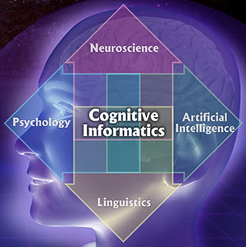
Recent initiatives
Latest (2010 & 2011):
The Mind and Brain Model Project (FP7 Flagship), lost
with the HBP project … (many partners/societies).
From Autism to ADHD: comprehensive approach; engaging experts in genetic, molecular, neural, simulations, behavioral & medical fields.
First CHIST-ERA Conference, “Consciousness and Creativity in Brain-Inspired Cognitive Architectures: Self-Awareness and Self-Consciousness” European Coordinated Research on Long-term Challenges in Information and Communication Sciences and Technologies.
GAMEWARE: Increasing Autonomous Bot Self-awareness in Games (Arrabales et al), creating reusable software modules to improve the levels of consciousness (esp. self-awareness) in autonomous systems.
NeuroCognitive approach to Natural Language Processing (NeCoNLP), a project written for Virtual Institute on Cognitive Systems, FP7 Network of Excellence (many partners).

Slide 43
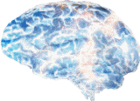

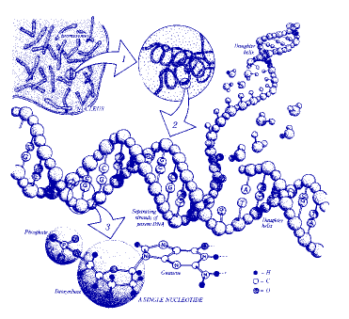
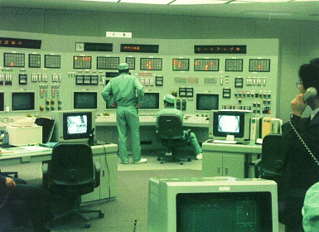
What is there to learn?
Industry: what happens with our machines?
Cognitive robotics: vision, perception, language.
Bioinformatics, life sciences.
Brains ... what is in EEG?
What happens in the brain?

Slide 44
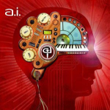
Meta-learning
Meta-learning means different things for different people.
Some call “meta” learning of many models, ranking them, boosting, bagging, or creating an ensemble in many ways , so for them
meta ⬄ optimization of parameters to integrate models.
Deep learning: DARPA 2009 call, methods are „flat”, shallow, build a universal machine learning engine that generates progressively more sophisticated representations of patterns, invariants, correlations from data.
Rather limited success so far …
Meta-learning: learning how to learn.
Meta-learning via search in the model space: similarity-based framework, kernel feature space construction, transfer-based learning, hetereogenous systems, k-separability, transformation-based learning, prototype rules for data understanding, separable f. networks …
Intemi software incorporating these ideas and more is coming “soon” ...

Slide 45
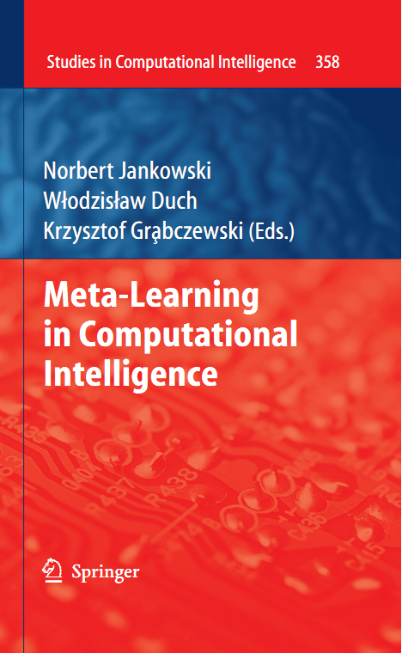


Slide 46

HIT: definition and goals
HIT is a computer/phone interface that can interact in a natural way with the user, accept natural input in form of:
speech and sound commands; text commands;
visual input, reading text (OCR), recognizing gestures, lip movement;
HIT should have a robust understanding of user
intentions for selected applications.
HIT should respond and behave in a natural way.
It may have a form of simulated talking head user
can relate to, an android head, or a robotic pet.
Major goals of the HIT project:
develop modular extensible software/hardware platform for HITs;
create interactive word games, information retrieval and other applications on PCs;
extend HIT functionality adding new interactivity & behavior;
move it to portable devices (PDAs/phones) & broadband services.

Slide 47

HIT: motivation
HIT software/hardware/services may find their way to a billion
portable devices/phones in a few years time. The value of
telephone ringtones alone in 2003 was 5 bln S$.
New telephone functions include: camera, speech recognition, on-line translation, interactive games and educational software.
Complexity of devices: a small fraction of the functions of electronic devices, such as PDAs, phones, cameras, or new TVs is used, new humanized interfaces that will help users are needed.
Many applications in education, entertainment, services; talking heads connected to knowledge bases are already used in E-commerce.
Creating HITs is a great computer engineering challenge, like building a rocket, it requires integration of many technologies and research themes, move research to a higher level. 17 SCE staff members expressed their interest and formulated HIT subprojects.
A test-bed is urgently needed to experiment with such technologies.

Slide 48

HIT: state of the art
HIT may draw from results of many large frontier programs, such as:
Microsoft Research, offering free speech recognition/synthesis tools and publishing work on Attentional User Interface (AUI) project.
DARPA’s Cognitive Information Processing Technology (call 6/2003).
European Union’s Cognition Unit (started 10/2004) programs that have a
goal to create artificial cognitive systems with human-like qualities.
Intel has projects in natural interfaces, providing free libraries for speech, vision, machine learning methods and anticipatory computing.
Talking heads already answer questions on Web pages for car,
telecom, banks, pharmaceutical & other companies.
Animated personal assistants work as memory enhancements and information sources, news, weather, show times, reviews, sports access...
Services answering questions in natural languages are coming: AskJeeves and 82ask give answers (human) to any question!
But ... HITs are not yet robust, are still very primitive in all respects, with limited interaction with the user, poor learning abilities, no anticipation ...

Slide 49
HIT: proposed approach
Proposed platform:
core functions: limited
speech, graphics, and natural language processing (NLP)
+ extended functions:
perceptual, cognitive, affective, specialized agents, behavioral.
Web/text/
databases interface
NLP
functions
Text to speech
Natural input modules
Graphical
talking
head
Cognitive functions
Behavior
control
Affective
functions
Control of devices
Specialized
agents
Challenge and opportunity is to build modular platform for HIT on a PC, with 3D graphical head, robust speech recognition, memory, reasoning + cognitive abilities, and move it to new phones/broadband services.
Uniqueness: nothing like that exists, requires a large-scale effort, integration and extension of many existing projects; collaboration with telecom and software industry, great student training.

Slide 50
DREAM/HIT – larger view …
Learning
Affective
computing
T-T-S synthesis
Behavioral
models
Brain models
Speech recognition
HIT projects
Cognitive Architectures
Talking heads
AI
Graphics
Robotics
Cognitive science
Lingu-bots
VR avatars
A-Minds
Knowledge
modeling
Info-retrieval
Working
Memory
Episodic
Memory
Semantic memory

Slide 51


DREAM top-level architecture
Web/text/
databases interface
Text to speech
NLP
functions
Natural input modules
Behavior
control
Talking
head
Cognitive functions
Control of devices
Affective
functions
Specialized
agents
DREAM project is focused on perception (visual, auditory, text inputs), cognitive functions (reasoning based on perceptions), natural language communication in well defined contexts, real time control of the simulated/physical head.

Slide 52

HIT sub-areas
Core functions: include HIT platform design/integration, robust limited vocabulary speech recognition, basic vision and learning; object and face tracking, synthesis of auditory and visual sensory signals, basic responses, control and talking head graphics.
Extended functions (13 experts) include synchronization of lip motion, analyzing prosody in speech, control of facial expressions, emotion analysis from face video, cognitive and affective functions, natural language analysis and context identification, cognitive learning, reasoning and theories of mind (user model), learning rules for behavior, integration with robot control, visual understanding, and hardware architecture design for selected applications.
Applications (5 experts) will initially include creation of specialized agents, implementing trivia / quiz/ educational and entertainment games, word games, 20 questions game, medical information presentation, office/ household automation, multi-lingual message (SMS, chat) understanding, an intelligent tutor to promote learning using appropriate gestures & more.

Slide 53
HIT benchmarks
First year: we should be able to demonstrate basic HIT platform with:
3D graphic head with control over rich facial movements coupled with
visual object and face tracking coordinated with basic responses;
robust limited vocabulary speech recognition for playing word games;
speech synthesis and copycatting;
following simple spoken commands;
interface with WWW search agents finding and presenting information;
full specifications for adding and interacting with HIT functions.
Second year: initial applications and extensions of the HIT platform,
work on the natural language processing and cognitive modeling:
demonstrate HIT playing the 20 questions game, selecting most informative questions that help to define the subject uniquely;
playing educational word games implementing trivia and quizzes;
medical information presentation system answering simple questions;
use of HIT in the NTU virtual campus;
organize an internal competition for new applications of HIT;
preliminary designs for moving the HIT platform to portable devices.

Slide 54
HIT extensions & management
Third year and later:
Improve existing platform and applications, move them to portable devices, add new functions needed for specific applications.
For example, auditory and visual scene analysis, fusion of sensory signals, testing of perceptual modules inspired by neuroscience,
applications of HIT for programming household devices, tutor programs to teach problem solving for some local courses.
A competition for adding such new functions and applications to the HIT platform will be made at NTU; this requires creation of test data, scenarios of use, providing specification for the interface, selection/sponsoring of the best proposed approach, and integration in the HIT.
Parallel project submitted to A*STAR: Developmental Robot-Embedded Artificial Mind (DREAM), aimed at controlling real android head, focused on comparison of general cognitive architectures; includes collaboration with 3 leading groups in cognitive modeling (Berkeley, Michigan and Memphis University), plus KAIST (Korea) on natural perception.

Slide 55





Query
Semantic memory
Applications, search,
20 questions game.
Humanized interface
Store
Part of speech tagger
& phrase extractor
verification
On line dictionaries
Active search and
dialogues with users
Parser
Manual

Slide 56


Emotion-Sensitive Systems
Humanized Interface [HIT]
(20Q Game)
  Natural human-like interaction:
  vision, speech (later: prosody);
  Knowledge representation, reasoning.
Intelligent Tutoring System
  Cognitive strategies for instruction
  and interaction (affect-based feedback).
  Cognitive skill epistemic game;
  dynamic curriculum delivery

Slide 57


Emotion-Sensitive Systems
Brain-Inspired Emotion
Recognition and Modeling
  Analysis of facial expressions.
  6 basic emotions: joy, anger, fear,
  sadness, surprise, disgust.
Mood-Sensitive Interface
(Mr. Bean)
  Reaction to user’s emotional state.
  Comments on surprise, sadness;
  prompting when no response.

Slide 58


NeuroCognitive Framework for Decision-Making (Meta-Level)
Plausible Computational Model
Application:
Option Pricing and Arbitrage Trading (GenSo-OPATS)
(Back)
C²i: NeuroCognitive Informatics Research Group

Slide 59
Neurocognitive Engineering

Slide 60
EEG based Neuro-feedback
Mental Training
EEG Signals
Brain
Statistical/ Neuro-fuzzy Modeling
EOG/ EMG/ ECG Signal
Sensorimotor Signals

Slide 61


IDoCare: Infant Development and Care for development of perfect babies!
Initially for Home 2015, but now it has a long story …
Problem: about 5-10% of all children have a developmental disability that causes problems in their speech and language development.
Identification of congenital hearing loss in USA is at 2½ years of age!
Solution: permanent monitoring of babies in the crib, stimulation, recording and analysis of their responses, providing guideline for their perceptual and cognitive development, calling an expert help if needed.
Key sensors: suction response (basic method in developmental psychology), motion detectors, auditory and visual monitoring.
Potential: market for baby monitors (Sony, BT...) is billions of $; so far they only let parents to hear or see the baby and play ambient music.

Slide 62

IDoCare intelligent crib
Revolutionary enhancement of baby monitors: intelligent crib with wireless suction, motion detector and audio/visual monitoring, plus software for early diagnostics of developmental problems.
Hardware: embedding pressure and temperature sensors in telemetric pacifier, for monitoring and feedback of baby's reactions to stimuli.
Software: signal analysis and blind source separation; interpretation of baby’s responses, selection of stimuli and comments for parents.
Home applications: monitoring, diagnostics, preventive actions by enhancement of perceptual discrimination by giving rewards for solving perceptual problems.
Children love to be stimulated, and IDoCare will be the first active environment that will allow them to influence what they see and hear.
Active learning may gently pressure baby’s brain to develop perceptual and cognitive skills to their full potential achieved now by very few.

Slide 63

More PerCog devices
Goal: enhance perceptual discrimination in all modalities, improve categorical perception, increase working memory span, long-term perceptual memory, encourage abstractions and faster reactions.
Responses to stimuli, behavioral interaction patterns should allow for early diagnosis of developmental problems.

Slide 64

Mars Analog, Software and Simulation Interdisciplinary Venture (MASSIVE)

Slide 65







From neurodynamics to P-spaces.
New type of modeling of mental events, I/O relations in psychological spaces.
W. Freeman: model of olfaction in rabbits, 5 types of odors, 5 types of behavior, very complex model in between.
Attractors of dynamics in high-dimensional space => via fuzzy symbolic dynamics allow to define probability densities (PDF) in feature spaces.
Mind objects - created from fuzzy prototypes/exemplars.

Slide 66


Trajectories for psycholinguistics
P.McLeod, T. Shallice, D.C. Plaut,
Attractor dynamics in word recognition: converging evidence from errors by normal subjects, dyslexic patients and a connectionist model.
Cognition 74 (2000) 91-113.
New area in psycholinguistics: investigation of dynamical cognition, influence of masking on semantic and phonological errors.

Slide 67

Platonic mind model.
Feature detectors/effectors: topographic maps.
Objects in long-term memory (parietal, temporal, frontal): local P-spaces.
Mind space (working memory, prefrontal, parietal): construction of mind space features/objects using attentional mechanisms.

Slide 68


Are geometric models possible?
Why geometric models are hard?
Too many dimensions to consider, so it is hard to see what happens.
Brains learn to estimate similarity, only a few dimensions may be related to perception-based experience.
Experience cannot be decomposed into components, in fact we are not able to describe our own experience – no phenomenology to model.
Eric Schwitzgabel, Russell T. Hurlburt, Describing Inner Experience?
Proponent Meets Skeptic, MIT Press (2007).
Eric Schwitzgabel, Perplexities of Consciousness, MIT Press (2011).
Can I be wrong about my own qualia? Yes!
Introspection proved to be of little use in the past.
We are not sure if we use mental images in thinking.
Do dreams are in color-sound? Not always clear.
How do we know what is tactile, auditory, visual?
What do I really know when I cannot recall image and name, but have a feeling that I know what it is about?

Slide 69



How to become an expert?
Textbook knowledge in medicine: detailed description of all possibilities.
Effect: neural activation flows everywhere and correct diagnosis is impossible. Correlations between observations forming prototypes are not firmly established. Expert has correct associations.
Example: 3 diseases, clinical case description, MDS description.
System that has been trained on textbook knowledge.
Same system that has learned on real cases.
Experienced expert that has learned on real cases.
Conclusion: abstract presentation of knowledge in complex domains leads to poor expertise, random real case learning is a bit better, learning with real cases that cover the whole spectrum of different cases is the best.
I hear and I forget.
I see and I remember.
I do and I understand.
Confucius, -500 r.

Slide 70
Imagery and brains
How and where are mental images formed?
Borst, G., Kosslyn, S. M, Visual mental imagery and visual perception: structural equivalence revealed by scanning processes.
Memory & Cognition, 36, 849-862, 2008.
The present findings support the claim that image representations depict information in the same way that visual representations do.
Cui, X et al. (2007) Vividness of mental imagery: Individual variability can be measured objectively. Vision Research, 47, 474-478.
Reported Vividness of Visual Imagination (VVIQ) correlates well with the early visual cortex activity relative to the whole brain activity measured by fMRI
(r=-0.73), and the performance on a novel psychophysical task.
Findings emphasize the importance of examining individual subject variability.
Poor perceptual imagery: why? Weak top-down influences?
Unable to draw from memory, describe details, faces, notice changes, etc.

Slide 71


Visual top-down
Normal perception requires top-down influences to form expectations.
What if PC/FC feedback connections to visual/auditory areas are weak?
This does not qualify as agnosia, but is a kind of imagery agnosia, a syndrom that has not yet been clearly identified!
How will the weak top-down connections in visual modality manifest?
Attention problems? Only if signals are very weak (ex. in poor lighting conditions) object recognition may be impaired.
Other symptoms: poor visual imagination, memory for visual features, inability to draw from memory, recall and describe faces and objects, notice changes, slow in making puzzles, difficulty to see 3D magic eye pictures, perhaps more introvert?
More conceptual than perceptual thinking … recognition memory may work fine.
At PC/FC level less interferences from sensory areas, so imagination, creativity, reasoning are fine, perhaps even better than average.

Slide 72

Imagery Agnosia
New branch of neuropsychology: imagery agnosias.
Classical agnosias ~30 major types: alexia, akinetopsia, alexithimia, many visual types: prosopagnosia, simultanagnosia, semantic agnosia , form, color …
Little access to perceptual imagery in visual, auditory, tactile or gustatory mode.
Without internal feedback the only way to learn about plans formed by the brain is to act and observe results: trying to play an instrument in this condition is like blindsight, maneuvering blindly in the auditory space, without the ability to imagine results of next move (hitting piano key).
Learning to play music without imagery is difficult – how far can one go?
Which key do I have to press if I have no idea how it will sound like?
Recognition memory is fine, but it is difficult to repeat or remember simple melodies (memory-motor map).
No problem to read & improvise music, higher cognition is fine.
Conscious mental rehearsal is not possible.
Immediate feedback may help?

Slide 73


Real & computational creativity
How to increase cooperation between distant brain areas important for creativity?
John H. Gruzelier (Imperial College), SAN President
α−θ neurofeedback produced “professionally significant
performance improvements” in music and dance students.
Neurofeedback and heart rate variability (HRV) biofeedback.
benefited performance in different ways.
Computational creativity, insight, curiosity simulation of
brainstorming, is a growing field – Neuroculture series of conferences in Torun.
BrainGene server that invents new names the way people do.
Duch W, Intuition, Insight, Imagination and Creativity.
IEEE Computational Intelligence Magazine 2(3), 40-52, 2007.
Pilichowski M, Duch W, Neurocognitive Approach to Creativity in the Domain of Word-invention. Lect. Notes in Computer Science 5507, 88–96, 2009

Slide 74



From Genes to Neurons
Genes => Proteins => ion channels, synapses
=> neuron properties, networks
=> neurodynamics => abnormal behavior!

Slide 75





From Neurons to Behavior
=> neuron properties, networks
neurodynamics => abnormal behavior! Autism, ADHD, epilepsy …
Help neuroscience to ask relevant questions.

Slide 76

Temporo-spatial processing disorders
B. Gepner, F. Feron, Autism: A world changing too fast for a mis-wired brain? Neurosci. Biobehav. Rev. (2009).

Slide 77


Excitatory and inhibitory neurons
Glutamic acid/ACh opens Na⁺ excitatory channels.
GABA inhibits neural activity working on Cl⁻ channels.

Slide 78


Model of reading & dyslexia
Emergent neural simulator:
Aisa, B., Mingus, B., and O'Reilly, R. The emergent neural modeling system. Neural Networks,
21, 1045-1212, 2008.
3-layer model of reading:
orthography, phonology, semantics, or distribution of activity over 140 microfeatures of concepts.
Hidden layers in between.
Learning: mapping one of the 3 layers to the other two.
Fluctuations around final configuration = attractors representing concepts.
How to see properties of their basins, their relations?

Slide 79

Attractors for words
Model for reading includes phonological, orthographic and semantic layers with hidden layers in between.
Non-linear visualization of activity of the semantic layer with 140 units.
Cost and rent have semantic associations, attractors are close to each other, but without accommodation transitions between basins of attractions are hard.
Will it manifest in verbal priming tests? Free associations?
Will broadening of phonological/written form representations help?
For example, training ASD children with characters that vary in many ways (shapes, colors, size, rotations).

Slide 80



Recurrence plots
Starting from the word “flag”, with small synaptic noise (var=0.02), the network starts from reaching an attractor and moves to another one (frequently quite distant), creating a “chain of thoughts”.
Same trajectories displayed with recurrence plots, showing roughly 5 larger basins of attractors and some transient points.

Slide 81

Long-term activity
A longer “chain of thoughts” starting from the word “flag” and going for 2000 iterations, with small synaptic noise (var=0.02), the network starts from reaching an attractor and moves to another one (frequently quite distant).
Same trajectories displayed with recurrence plots, showing roughly 5 larger basins of attractors and some transient points.

Slide 82


Normal-ADHD
All plots for the flag word, different values of b_inc_dt parameter in the accommodation mechanism. b_inc_dt = 0.01 & b_inc_dt = 0.02
b_inc_dt = time constant for increases in intracellular calcium which builds up slowly as a function of activation.
http://kdobosz.wikidot.com/dyslexia-accommodation-parameters

Slide 83

Normal-Autism
All plots for the flag word, different values of b_inc_dt parameter in the accommodation mechanism. b_inc_dt = 0.01 & b_inc_dt = 0.005
b_inc_dt = time constant for increases in intracellular calcium which builds up slowly as a function of activation.
http://kdobosz.wikidot.com/dyslexia-accommodation-parameters

Slide 84




Inhibition
Increasing
g_{i} from 0.9 to 1.1 reduces the attractor basin sizes and
simplifies trajectories.
Strong inhibition,
empty head …

Slide 85

Mistaking symptoms for causes
Various brain subsystems develop in an abnormal way:
1. Abnormal functional connectivity between extra striate and temporal cortices during attribution of mental states, and executive tasks such as memory for or attention to social information (Castelli et al., 2002 ; Just et al., 2004, 2007; Kana et al., 2007a, b; Dichter et al., 2007; Kleinhans et al., 2008).
2. Underconnectivity: working memory, face processing (Just et al., 2007; Koshino et al., 2008; Bird et al., 2006), cortico-cortical connectivity (Barnea-Goraly et al., 2004; Herbert et al., 2004; Keller et al., 2007).
3. Default mode network: “Results revealed that while typically developing individuals showed enhanced recall skills for negative relative to positive and neutral pictures, individuals with ASD recalled the neutral pictures as well as the emotional ones. Findings of this study thus point to reduced influence of emotion on memory processes in ASD than in typically developing individuals, possibly owing to amygdala dysfunctions.”
C. Deruelle et al., Negative emotion does not enhance recall skills in adults with autistic spectrum disorders. Autism Research 1(2), 91–96, 2008

Slide 86
Brains and Singapore
Challenge: creation of a center of competence on brain-related topics.
Comprehensive program to build competence in this area.
It will eventually happen anyway. It will change everything, the way we work and live. Imagine the consequences … Time for brain science is ripe!
Comprehensive program, not 100 separate projects.
Building: artificial brains, HBP, neurorobotics, robot companions
Interacting Brains: BCI, social aspects, affective computing, ICTFutur
Focus on applications: medical, cognitive and autonomous robotics …
Protecting & Maintaining: infant development, aging assistive technologies, neuroplasticity, neurorehabilitation …
Understanding the brain: basic neuroscience, creativity and imagery, understanding trust and deception, understanding ourselves.
Integrate efforts: CoE + HSS + ADM + SPMS + SBS + NIE ++
Collaborate: EU/USA/Japan large scale programs.

Slide 87



Phantomology: the virtual reality of the body. Theoretical aspects and hands-on demonstrations (co-organized with Dept. of Neurology, University Hospital Zurich), with Olaf Blanke, Peter Brugger, Henrik Ehrsson, Kevin O’Regan and others (26-28.09.2011).
Brain and Music, May 2012, Brain and Dance (2013), Brain and Art (2014)
Crossmodality and synesthesia (2012)

Slide 88

Exciting times are coming!
Thank you for synchronizing your neurons and lending your ears
Google: W Duch
=> Papers, Talks, Photos, Music etc.

