Slide 1
Dynamic Semantic Visual Information Management
Włodzisław Duch
Nicolaus Copernicus University, Poland
Nanyang Technological University, Singapore Google: W Duch
Julian Szymański Gdańsk University of Technology, Poland
IMS, August 2010

Slide 2
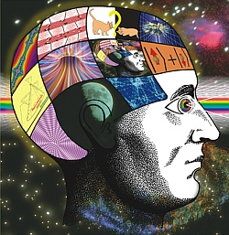
Scientific problem
How do brains, using massively parallel computations, represent knowledge and perform thinking?
L. Boltzmann (1899): “All our ideas and concepts are only internal pictures or if spoken, combinations of sounds.” „The task of theory consists in constructing an image of the external world that exists purely internally …”.
L. Wittgenstein (Tractatus 1922): thoughts are pictures of how things are in the world, propositions point to pictures.
Kenneth Craik (1943): the mind constructs "small-scale models" of reality to anticipate events, to reason, and help in explanations.
P. Johnson-Laird (1983): mental models are psychological representations of real, hypothetical or imaginary situations.
J. Piaget: humans develop a context-free deductive reasoning scheme. Pictures? Or FOL logic? Or both + other representations? What really happens in the brain? Can we do it in software?

Slide 3
Practical motivation
Keyword based search engines are quite limited due to semantic ambiguity.
Humans have associations and expectations, but may lack knowledge of precise terms needed to retrieve information in new domains, where specific vocabulary is needed.
Exploration of articles in large encyclopedia is difficult, too many links, no overview of the domain filtered through the interest of the user: start from article on „neuroscience”, but show only those links related to „attention” and „neural synchronization”?
Static links are not sufficient: priming processes in the brain create functional networks on the top of neurolinks, we pay attention to those things that are matched to appropriate contexts.
Semantic priming: making way for neural activation flow that excites diverse brain areas, making them susceptible to relevant information, disambiguating concepts, facilitating unique interpretation of incoming information (including speech and texts).

Slide 4
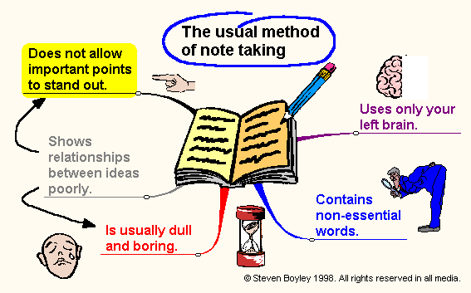
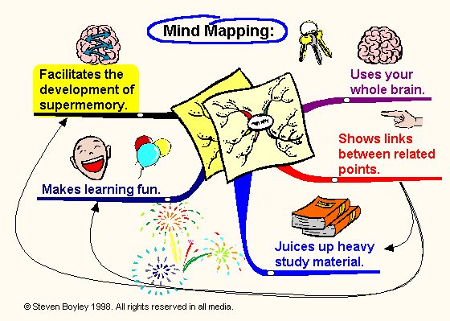
Brain maps
Best: organize info like in the brain of an expert.
Many books on mind maps.
Many software packages.
TheBrain (www.thebrain.com) interface making hierarchical maps of Internet links.
Other software for graphical representation of info.
Our implementation (Szymanski): Wordnet, Wikipedia graphs
extension to similarity is coming.

Slide 5
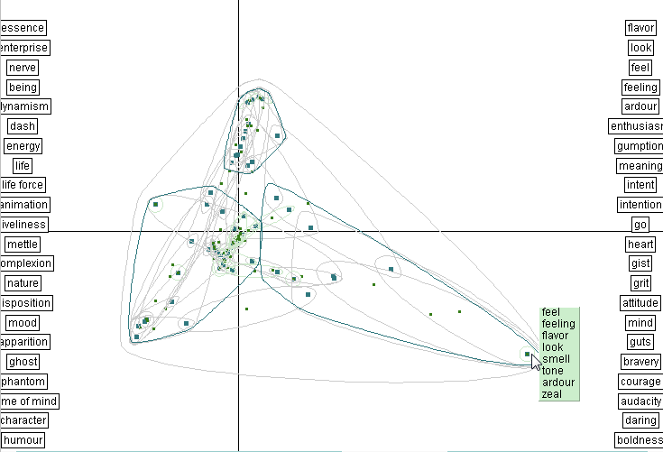
Semantic Atlas
http://dico.isc.cnrs.fr/en/index.html
spirit: 79 words 69 cliques,
or minimal
units of
meaning.
Synset =
set of
synonyms

Slide 6
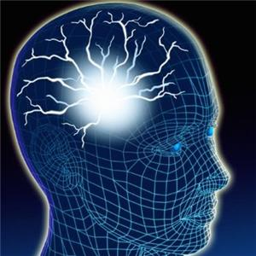
Practical solution
Problems with hypertext links:
Links are quite useful, but are they should be removed/added automatically depending on the interest of the user browsing through the articles.
Links may be too numerous (long Wiki articles).
Important links may be missing, and free texts has no links.
The best use of links is to explain single concept, not document similarity.
Links should be at different levels of hierarchy: concepts => definitions, topics, articles; topic=>topic; article-article.
Graphs showing document similarity give alternative representation of the whole domain.
Clustering is one way for identifying groups of related objects (topics). Drawback: clusters are static, not related to specific queries.
Start from clusters and restructure them in the direction given by the user.

Slide 7
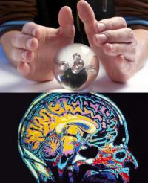
Scientific discovery
Science is about hypothesis = links between concepts, topics, ideas … if we could find automatically such links in the literature we could make scientific discoveries!
Microsoft MindSpace: simple links between a pair of words, looking for sentences with shortest distance, showing links , ex: peep ↔ horn ↔ car, plus some info on types of relations.
Help to make scientific discoveries through literature mining, find non-obvious connections between biological entities: disease, genes, proteins, metabolites, drugs …
Example: Biomine http://biomine.cs.helsinki.fi
Search for connections between (Autism, ADHD).
Results: no direct links yet.
Similar: Pub Brain and Pub Graph: search for links in PubMed repository.

Slide 8
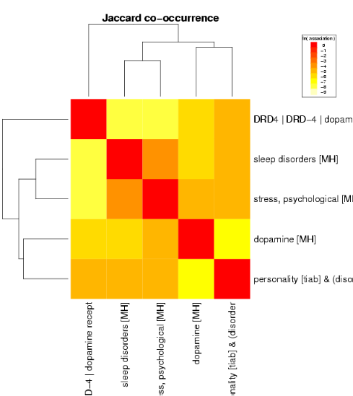
Pub Graph
Pub Brain and Pub Graph:
search in PubMed
http://www.pubgraph.org
Examples of graphs:
use heat maps and dendrograms to show correlation of concepts.
Not too good …

Slide 9
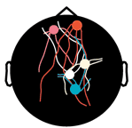
Dynamic clustering algorithm
An algorithm for dynamic presentation of semantic relations that allow to select documents that are similar from a particular point of view.
Define the search domain, cluster all documents D_{i} in this domain using the vector space model, i.e. representing documents by vectors V(D_{i}).
Provide a set of keywords {Key_{j}} for priming, or alternatively a reference document from which such keywords will be extracted.
Determine additional concepts {K_{k}} that are correlated with keywords {Key_{j}}, including their synsets, and estimate the strength of these concepts calculating linear correlation coefficients p_{k}.
Rescale components of V(D_{i}) vector corresponding to expanded keywords using only important correlations, ex. p_{k} > 0.6.
Perform new clustering based on modified vectors.
Visualize clusters, providing new dynamic view on relations among documents in the search space.
This algorithm tries to use both keywords and overall similarity.

Slide 10
Semantic Network
This algorithm has been tested on two knowledge domains: first the animal kingdom domain. Semantic networks were created from analysis of texts to determine properties of concepts, corrected by using the 20 questions game to generate verify concept descriptions.
Semantic network represents here general knowledge, but we want to see only subset of the whole network relevant to the query.

Slide 11
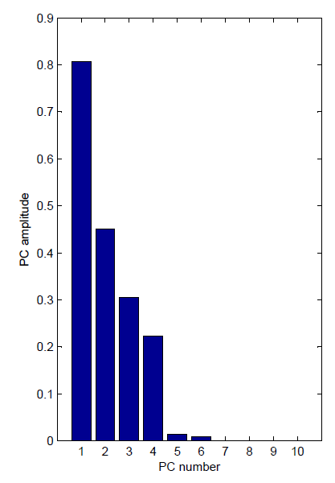
Semantic mapping of words
Samsonovich & Ascoli (2008) took all synonym and antonym definitions from MS Word thesaurus (over 8000), performed PCA analysis.
PC1: increase, well, rise, support, accept … drop, lose, dull, break, poor…
PC2: calm, easy, soft, gentle, relaxed… difficult, harsh, hard, trouble, twist …
PC3: start, open, fresh, begin, release… close, delay, end, finish, halt …
PC4: thin, edge, use, length, wet… center, save, deep, dry, middle…
1: positive-negative
2: calming-exciting
3: open-closed
4: basic-elaborate

Slide 12
Semantic Network: PCA Projection
Sematic network is based on vectors describing concepts; the matrix of these concepts may be represented in coordinates with maximum variance, i.e. Principal Component Analysis done via Singular Value Decomposition (SVD).
The rough view of the data in this space shows three large clusters for reptiles, birds and mammals, and two animals that do not fir to these clusters: shark and frog.

Slide 13
Self-Organized Map: idea
Data: vectors X^{T} = (X₁, ... X_{d}) from d-dimensional space.
Grid of nodes, with local processor (called neuron) in each node.
Local processor # j has d adaptive parameters W^{(j)}.
Goal: change W^{(j)} parameters to recover data clusters in X space.

Slide 14
Self Organizing Maps for Animals
The semantic network can be also visualized using the Self Organizing Map (SOM).
Each cell clusters documents or concepts that are roughly similar, but similar in the sense of overall distribution of all words.
Rescaling features allows to introduce points of view related to queries.
Same technique may be used on a set of documents rather than concepts.

Slide 15
Reorganized SOM
Application of the dynamic clustering algorithm leads to complete reorganization of SOM clusters.
Here we ask for similarities between animals that have beak. Additional terms that are correlated with beak are automatically added with proper weights: bird, fly, eggs.
Irrelevant objects (animals) are placed far away from the lower area where typical, less typical and quite unique animals with beaks are placed.

Slide 16
Adding keywords to SOM
Another reorganization takes place if the keyword fly is added; it is correlated with eggs, beak, bird
The dynamic algorithm shows separately birds , distinguishes domestic birds as a special subgroup, bat as unique flying animal, other animals are placed rather far.
Color coding may also be used to show similarity of clusters.

Slide 17
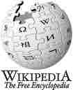
Wikipedia: text representation
The Wikipedia can be seen as large graph formed by hyperlinks between articles. How to represent documents by vectors?
Normalized frequency of words (terms, or words after stemming), or concepts (collocations, phrases) is usually taken, but the dimensionality of feature spaces is very large ~ 10⁵.
Links can be used for sparse binary representation of articles, dimensionality = number of articles in the collection.
Similarity between articles may be used, with various similarity measures, Kolmogorov complexity measured by the compression rate is one of the best. Dimensionality is then also equal to the number of articles in the collection, but representation is not sparse.
Dimensionality can be reduced using PCA or other techniques.

Slide 18
Dimensionality reduction by PCA
660 articles about philosophers from Wikipedia have been selected.
The 660D feature space based on links may be approximated rather accurately by less than 20 features created by PCA (combinations, or link patterns), with first component clearly playing dominant role.
Text representation using algorithmic complexity leads to even faster convergence.
Perhaps philosophy is not so difficult!

Slide 19
SOM for philosophers
Articles about 17 philosophers, represented by 660 features based on links:
SOM maps for original 660D data and for 16D data based on principal components looks identical.

Slide 20
SOM with more directions
The user search can run in many directions.
The most interesting directions are shown by principal components that bind together similar original concepts.
Eg. Kant and Hegel have been placed together.

Slide 21
12th component
Enhancing different PCA components clusters containing different concepts are created, representing different points of view on similarity between concepts.
Interpretation is not quite straightforward if PCA are used, unless there is a clear semantic interpretation of PCA direction.

Slide 22
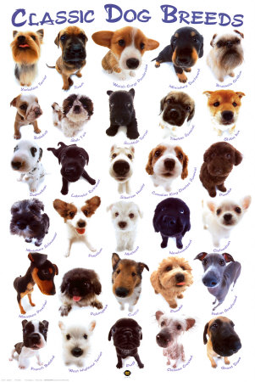
Dog breeds
329 breeds in 10 categories:
Sheepdogs and Cattle Dogs; Pinscher and Schnauzer; Spitz and Primitive; Scenthounds; Pointing Dogs; Retrievers, Flushing Dogs and Water Dogs; Companion and Toy Dogs; Sighthounds
Write down properties and try to use them in the 20-question game to recognize the breed … fails!
Visually each category is quite different, all traditional categorizations are based on behavior and features that may not be easy to observe.
Ontologies do not agree with visual similarity.
Understanding is easy if you know it => not all brain states have linguistic labels.
Language communication is thus limited to what we already know!
You see what you know, you know what you see.

Slide 23
Dog behavior

Slide 24
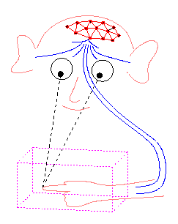
Conclusions
To reach human level competence in information
comprehension and management we may need to create algorithms that work in a similar way as brains do.
Neurocognitive inspirations are becoming important in formulating interesting ideas that can be converted into algorithms.
Artificial Neural Networks were based on inspirations at rather low level of single neurons. We need more inspirations at a higher level.
For example, dynamic functional connectivity graphs for information retrieval and flexible organization, discovery of new knowledge, Wiki browsing is now at: http://semanticspaces.eti.pg.gda.pl:8888/wikiparser
How do higher cognitive functions map to the brain activity?
Creativity = neural space (knowledge, preparation) + activity variations (imagery)+ filtering of results (emotions).
Neurocognitive informatics = abstractions of this process .

Slide 25
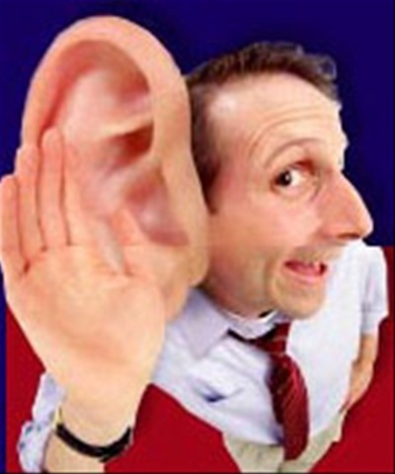
Thank you for lending your ears ...
Google: W Duch => Papers, presentations, projects

